Slide 1
Managing Your Supervisor
Professor Joe Luca
Dean, Graduate Research School

Slide 2
Overview
Supervisor Training Website & GRIP
Supervisor Performance, Rules & Support
The Process of Supervision
Managing your Supervisor
Q&A

Slide 3
What is the single most important issue which will dictate the success of a HDR Candidate?

Slide 4
Blackboard Supervisor Site
Log into Blackboard at http://blackboard.ecu.edu.au/
On left hand side, go to “Search For”, and in the “Communities” box, enter exactly “Supervising HDR Candidates at ECU”
On the bottom right of the next screen, click “Enrol”
Click “Submit”, and then “ok”
The community site will then appear.

Slide 5
GRIP
Getting Started
Getting Organised
Working with your supervisor
Searching the literature
Confirmation of Candidature
Literature Review & Research Methodology
Responsible Research

Slide 6
Section 1
Supervisor Performance, Rules & Support

Slide 7
New Initiatives & Changes
See “New Initiatives” forum on BB, includes
PhD by Publication Guidelines
Nominating reviewers Guidelines
Nominating examiners Guidelines
Online Induction (GRIP) compulsory in 2011
Turnitin compulsory in 2011
Exit Surveys and interviews
“Submission & Retention of HDR Thesis” Policy
New Honours Policy soon!

Slide 8
HDR Support Services

Slide 9
GRS Support Services
See “GRS Initiatives 2011” Handout
See GRS website http://www.research.ecu.edu.au/grs/
  ESL Programs http://www.research.ecu.edu.au/grs/resources/esl.php
  HDR Research Training – see GRS Calendar
  FOPS – See GRS Calendar
  Research Week: 15-19th August, which includes
    3 Minute Thesis & Visualising Research
  Rules, Policies and Guidelines
  Researcher Listserv on Google Groups (~250 users)
  Work register, etc..
Research Online: http://ro.ecu.edu.au/

Slide 10
Academic Writing Support
Greg Maguire & Jo MacFarlane
Supervisors need to check students work EARLY, In the first couple of months!
Not an editing service but seek to develop student writing skills
Works best if they work with research students throughout their candidature
Prefer to edit their work before the Supervisor(s) does

Slide 11
Section 2
The Process of Supervision

Slide 12
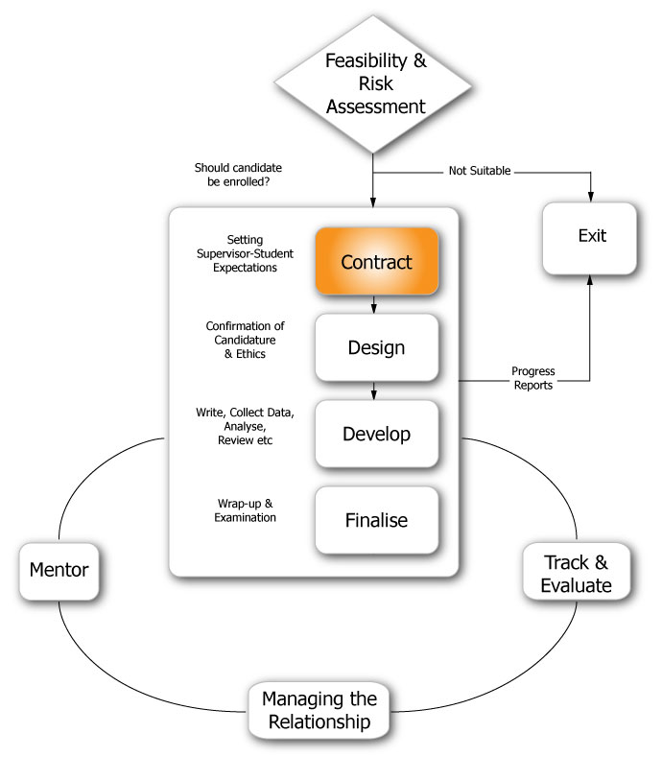
Contract
Joe Luca

Slide 13
  Setting Expectations
  “First Interview Checklist” (Supervisor Policy)
  “Expectations in Research Supervision” questionnaire
  Meeting format and structure?
  “Record of Supervisor-Student Meetings”
  Frequency of meetings?
  Feedback type, and quality?
Learning plan to help develop these skills
    “Student Skills Audit” questionnaire
    ECU Support Services
Timeline and milestones
  Planning and tracking progress?
  Reviewing targets?
Notes:
Show clip “Communicating Expectations”
Themes discussed include: setting up meetings, student collaboration (a thesis family for support), what to do when a student “disappears”

Slide 14
Successful PhD Completions
On campus with desk space and computer are twice as likely to complete
Supervisor meetings once a week are most likely to complete
Defining project earlier in candidature, and encouraging students to start writing early!
If paid work hours > 30 hours, completion rates are low
Scholarship students more likely to complete

Slide 15
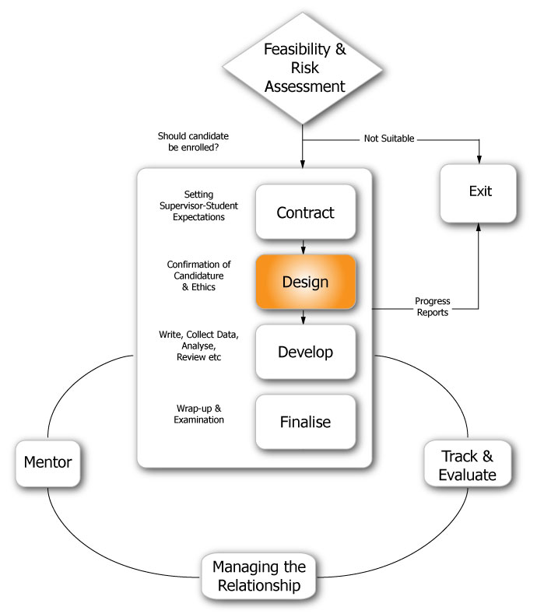
Design
Joe Luca

Slide 16
Confirmation of Candidature
CRITICAL PHASE! See Milestones
Gather information about the topic
  “Create a Reading List”
  Does the research have value?
  Scale/complexity of thesis appropriate?
  Is the time frame realistic?
Frequent meetings with supervisor needed to produce refined blueprint!
“Choosing & Refining a Research Topic & Question”
See other resources on website

Slide 17
Proposal Length, Reviewers & Ethics
Proposal Length ~20 pages
  An outline of the thesis, not the literature review!
“Nomination of Reviewers” (Guidelines and Forms)
  Should be selected carefully for valuable input
  Can be either internal/external or both
  Should be nominated `2/3rds into candidature
Start thinking about ETHICS early
  NO retrospective approval
  Data cannot be used (research misconduct)
  STREAM & Ethics Website
    Kim Gifkins 2170
    research.ethics@ecu.edu.au

Slide 18
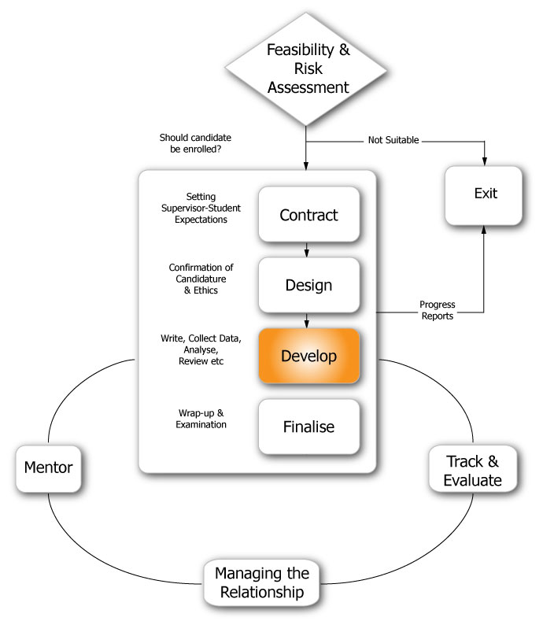
Develop
Joe Luca

Slide 19
Write, Collect Data, & Analyse
Write Often & Early - Get ideas down! See Resources
  “Giving Quality Advice on Candidates Writing” &
  “Promoting Writing by Research Students Throughout Candidature”
  Promoting Publishing & conference attendance
  Discuss Authorship (Vancouver Protocol)
Use of appropriate technology & training
  Endnote, thesis templates, styles, Library/Journal Databases, Google Scholar, etc.
Carefully consider how you give Feedback
  Scaffold and Fade!
  Ensure students understand feedback, give examples
  Encourage discussion of feedback with others
Notes:
Show YouTube clip “Giving and Receiving Feedback” Topics cover the challenges of writing when from a Non-English speaking background, issues for supervisors on how to give quality feedback, grammar vs. ideas, turnaround time on giving feedback.

Slide 20
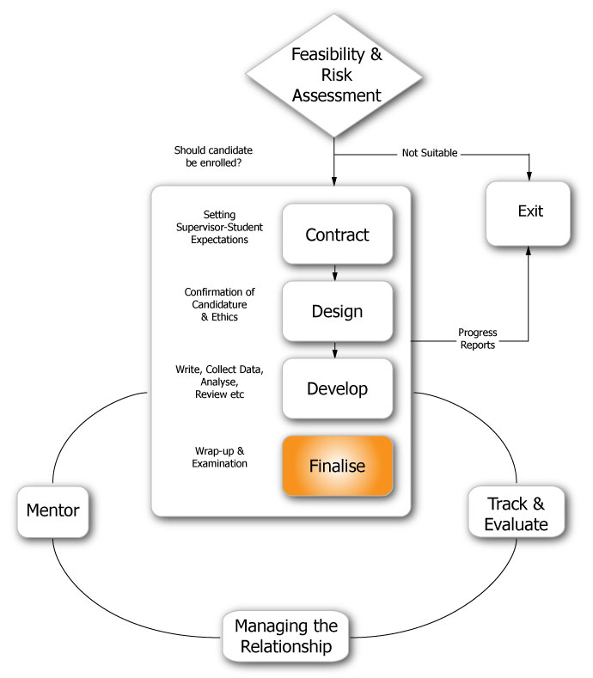
Finalise
Joe Luca

Slide 21
Selection Examiners
Very important stage!
“Nomination of Examiners” (Guidelines & Forms)
Area of research activity, expertise & reputation – specialists in theory, methods, research contexts
Experienced examiners preferred over new ones
Higher tolerance and better feedback to get candidate passed
What are examiners looking for?
  “Consideration of Nomination of Examiners” (Resources)
ANU Website information of preparing for examination, selecting examiners and the examination process at
  http://researchsuper.cedam.anu.edu.au/examination

Slide 22
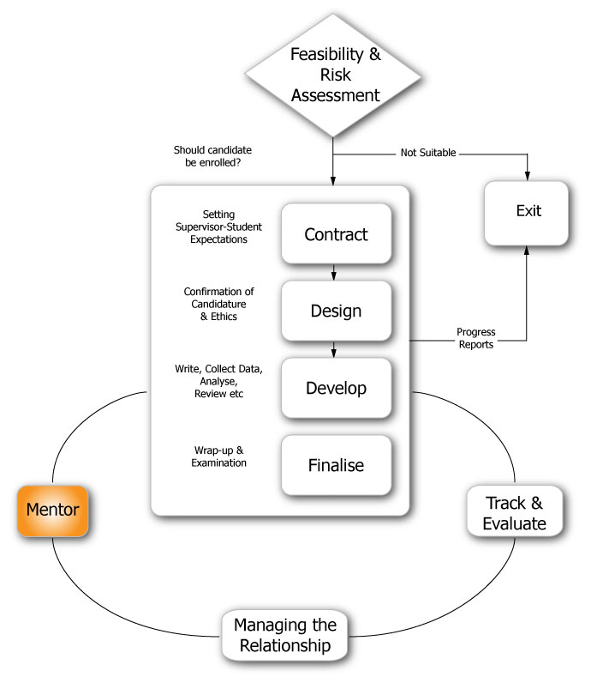
Mentor
Joe Luca

Slide 23
Mentoring
“My mentor was someone who provided me with career development advice, insights into company culture and processes, technical knowledge, invited me to co-author papers with him, introduced me to his professional network and provided me with opportunities I would never have been readily exposed to.”
Marian Patrick, ECU PhD Candidate

Slide 24
Scaffold and Extend
Use scaffolding to build student
confidence
Extend students beyond what
they thought possible!
Set high but realistic standards
through scaffolding
Encourage independence by building students’ confidence in their personal research capabilities
Students need to take increasing ownership over the project…

Slide 25
Career Planning
Career planning? How are you helping them develop career skills, contacts and ambitions?
  Encourage research seminars and journal clubs
  Ensure interaction with quality researchers
  Sessional teaching opportunities?
  Promote conference experiences, particularly international
  Encourage publishing
  Promote interaction with other students in the discipline
  Provide skills, help or consultants to help at the right time
SOAR Centre

Slide 26
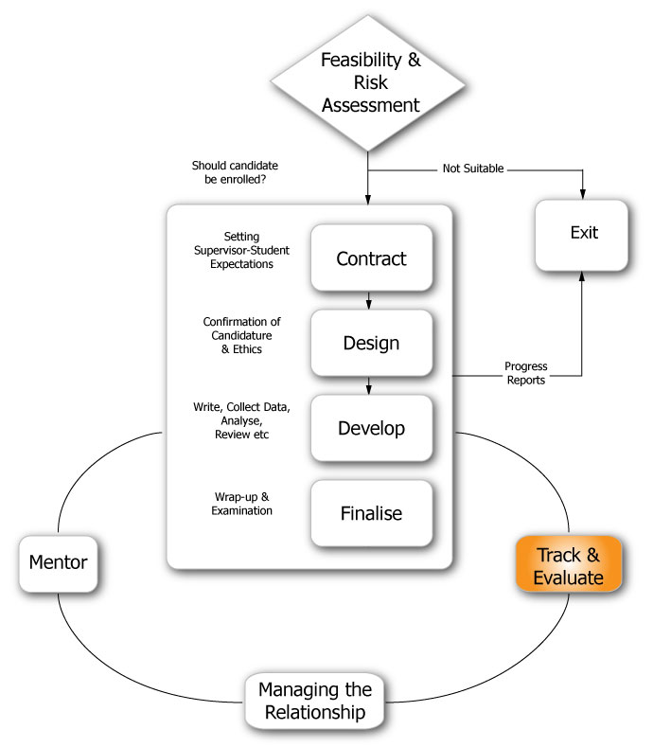
Track & Evaluate
Joe Luca

Slide 27
Track & Evaluate
Compare progress with established schedule - Are they performing according to the initial agreement?
Doctoral students are funded for 4 EFTSL
What to do after 3 EFTSL
On track?
Part Time enrolment?
Milestone meetings with Assoc Deans at around 3.5 EFTSL

Slide 28
Formal Meetings
Agenda
Milestones and thesis plan (Chapters)
Response to written work, structure and details? Feedback clarity?
Record decisions, achievements and future actions with mutual agreement to research tasks?
  use an exercise book with dates, tasks, ideas etc..
Next meeting (how regular?)

Slide 29
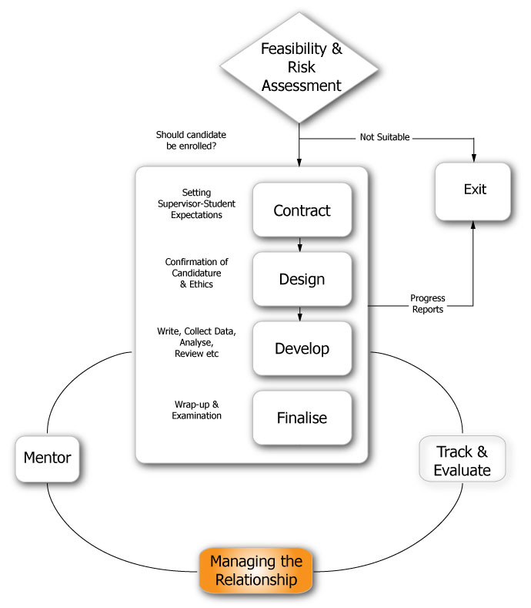
Manage the Relationship
Joe Luca

Slide 30
When Problems Arise
Who to Contact?
ECU Grievance procedures for fairness and equity:
  Student Complaints Process for products or services
  Student Appeals Committee for academic issues

Slide 31
Section 3
Managing your Supervisor

Slide 32
Supervisor & Researcher Qualities
Outline three characteristics or qualities you expect from a good:
  Supervisor
  Research Candidate

Slide 33
What should you do?
If you experience conflict, confusion, or perceived lack of support from your supervisor, what should you do?
Do you foresee any potentially problematic areas as part of your research? If so, is your supervisor aware and proactive? Are you proactive?

Slide 34
Potential Problems
Do you foresee any potential problems in your research? If so,
  Is your supervisor aware of these and proactive in helping to solve them?
  Are you proactive?

Slide 35
Q&A

Slide 36
Good Supervision
Supports candidate with clear advice and expertise
Gives clear and timely feedback
Monitors progress
Praises & nurtures
Has good interpersonal skills
Encourages skill development, with central resources and research centres
Provides network of scholars & examiners
Identifies non-performing candidates and uses the Marginal Progress option

