Slide 2
EXPERIENCES IN COLLABORATIVE RESEARCH WITH INDUSTRY: ADVANTAGES AND RISKS
Dr Greg Maguire
Research Writing Consultant
Faculties of Business & Law and
Computing, Health & Science

Slide 3
Summary of Research Career
PhD and Research Scientist (NSW Fisheries) – initiating the marine prawn farming industry.
Academic at University of Tasmania – mostly researched oyster culture (also clams & abalone).
Research Manager (Dept. of Fisheries, WA) – some research on prawn, marron & abalone farming and rock lobster research.

Slide 4
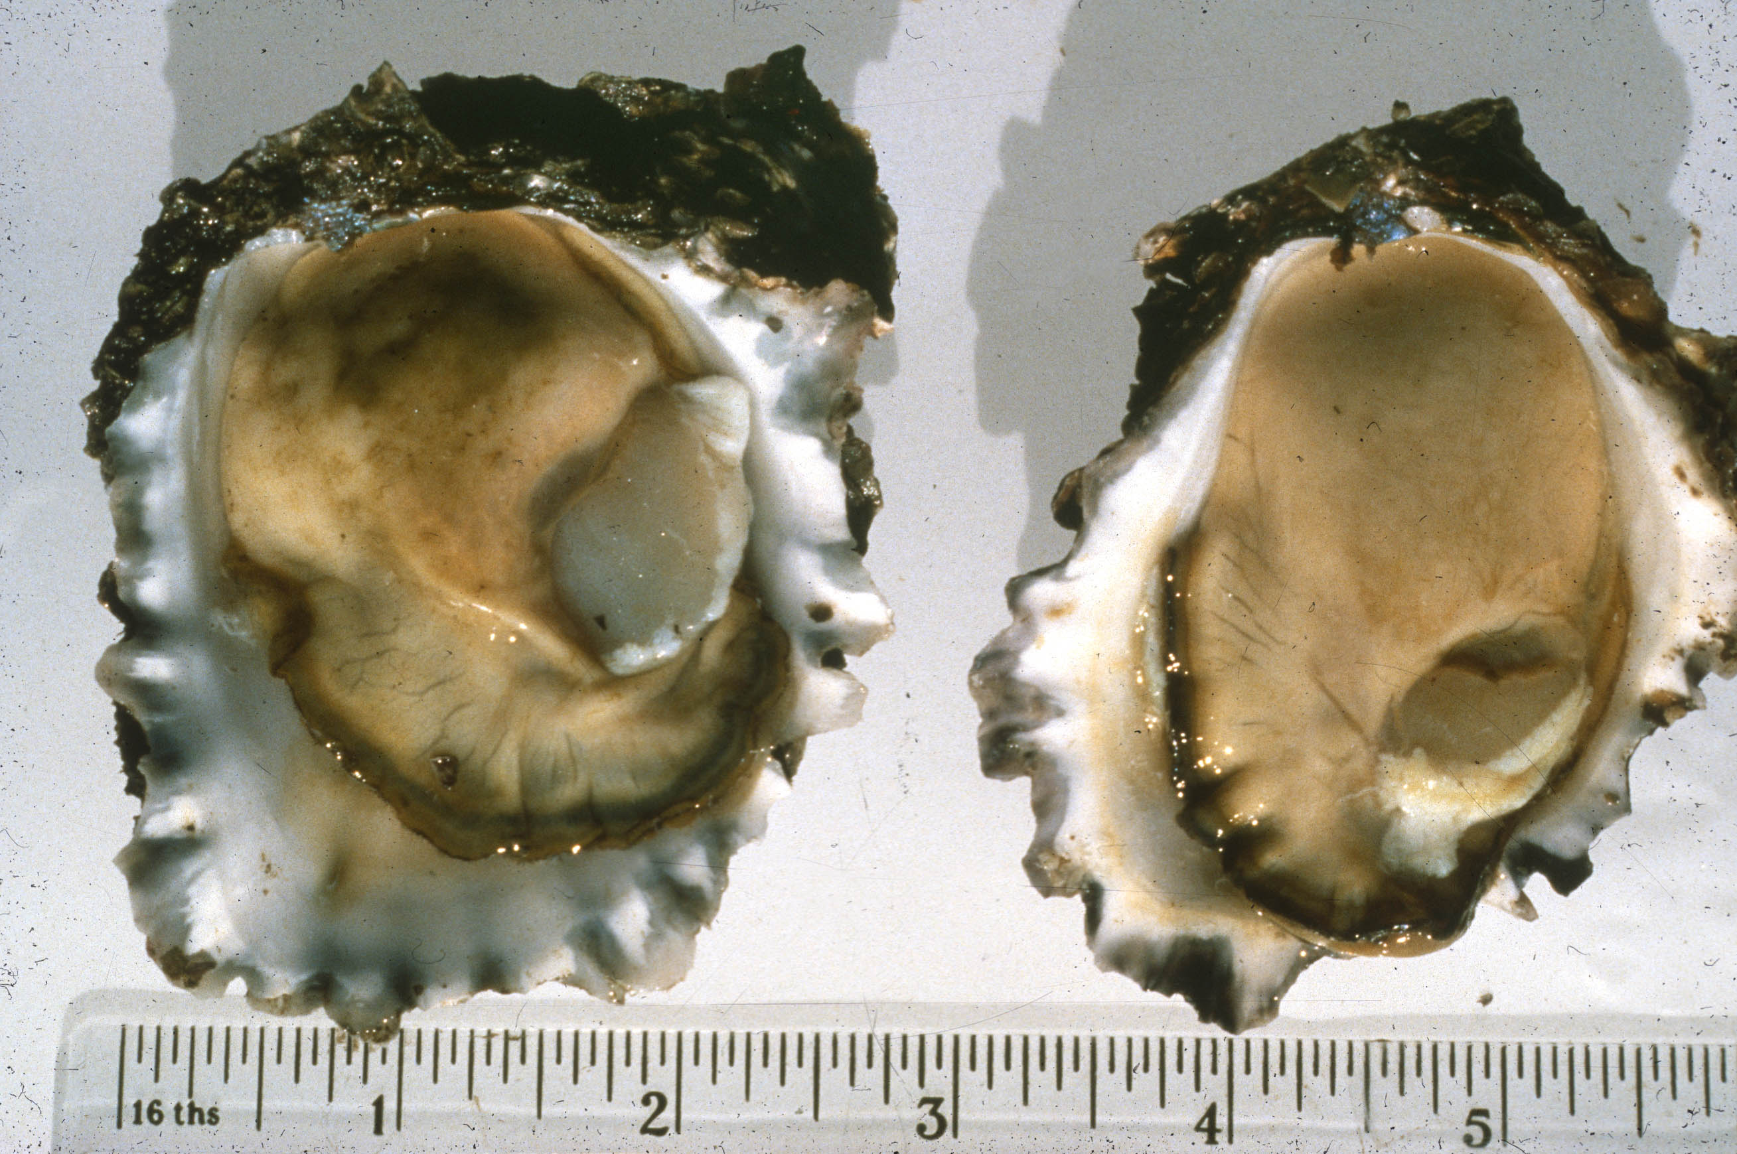

Slide 5
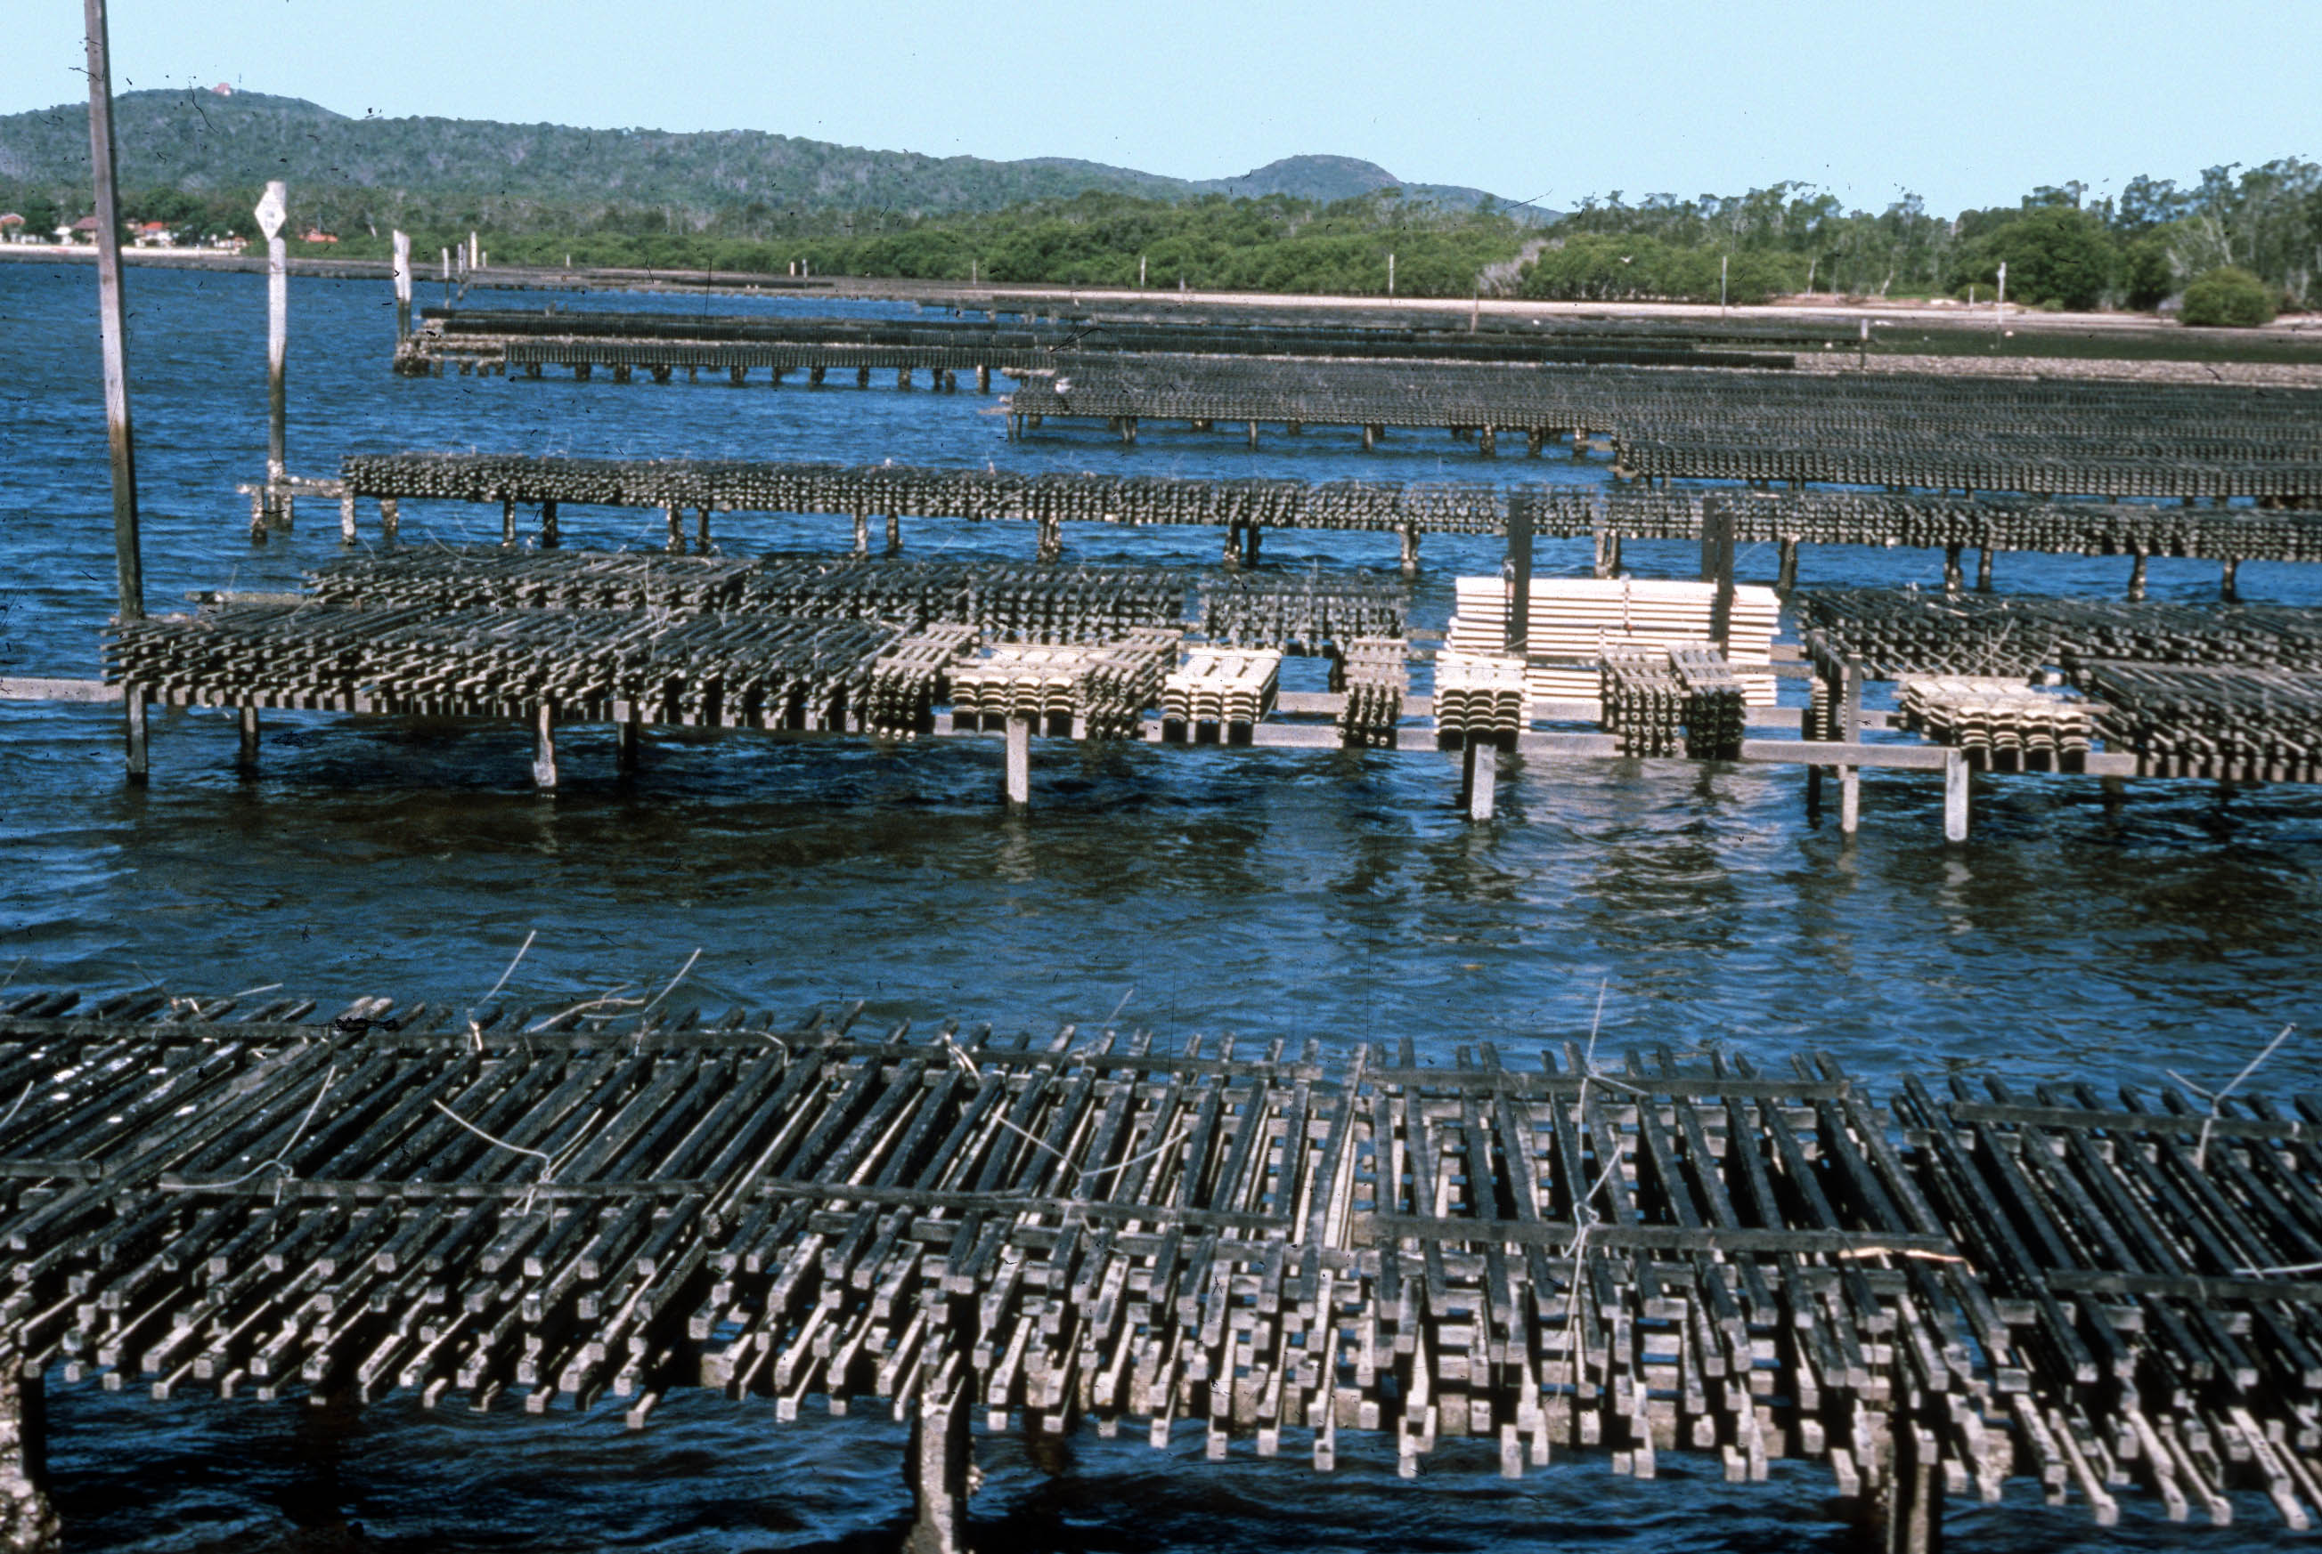

Slide 6
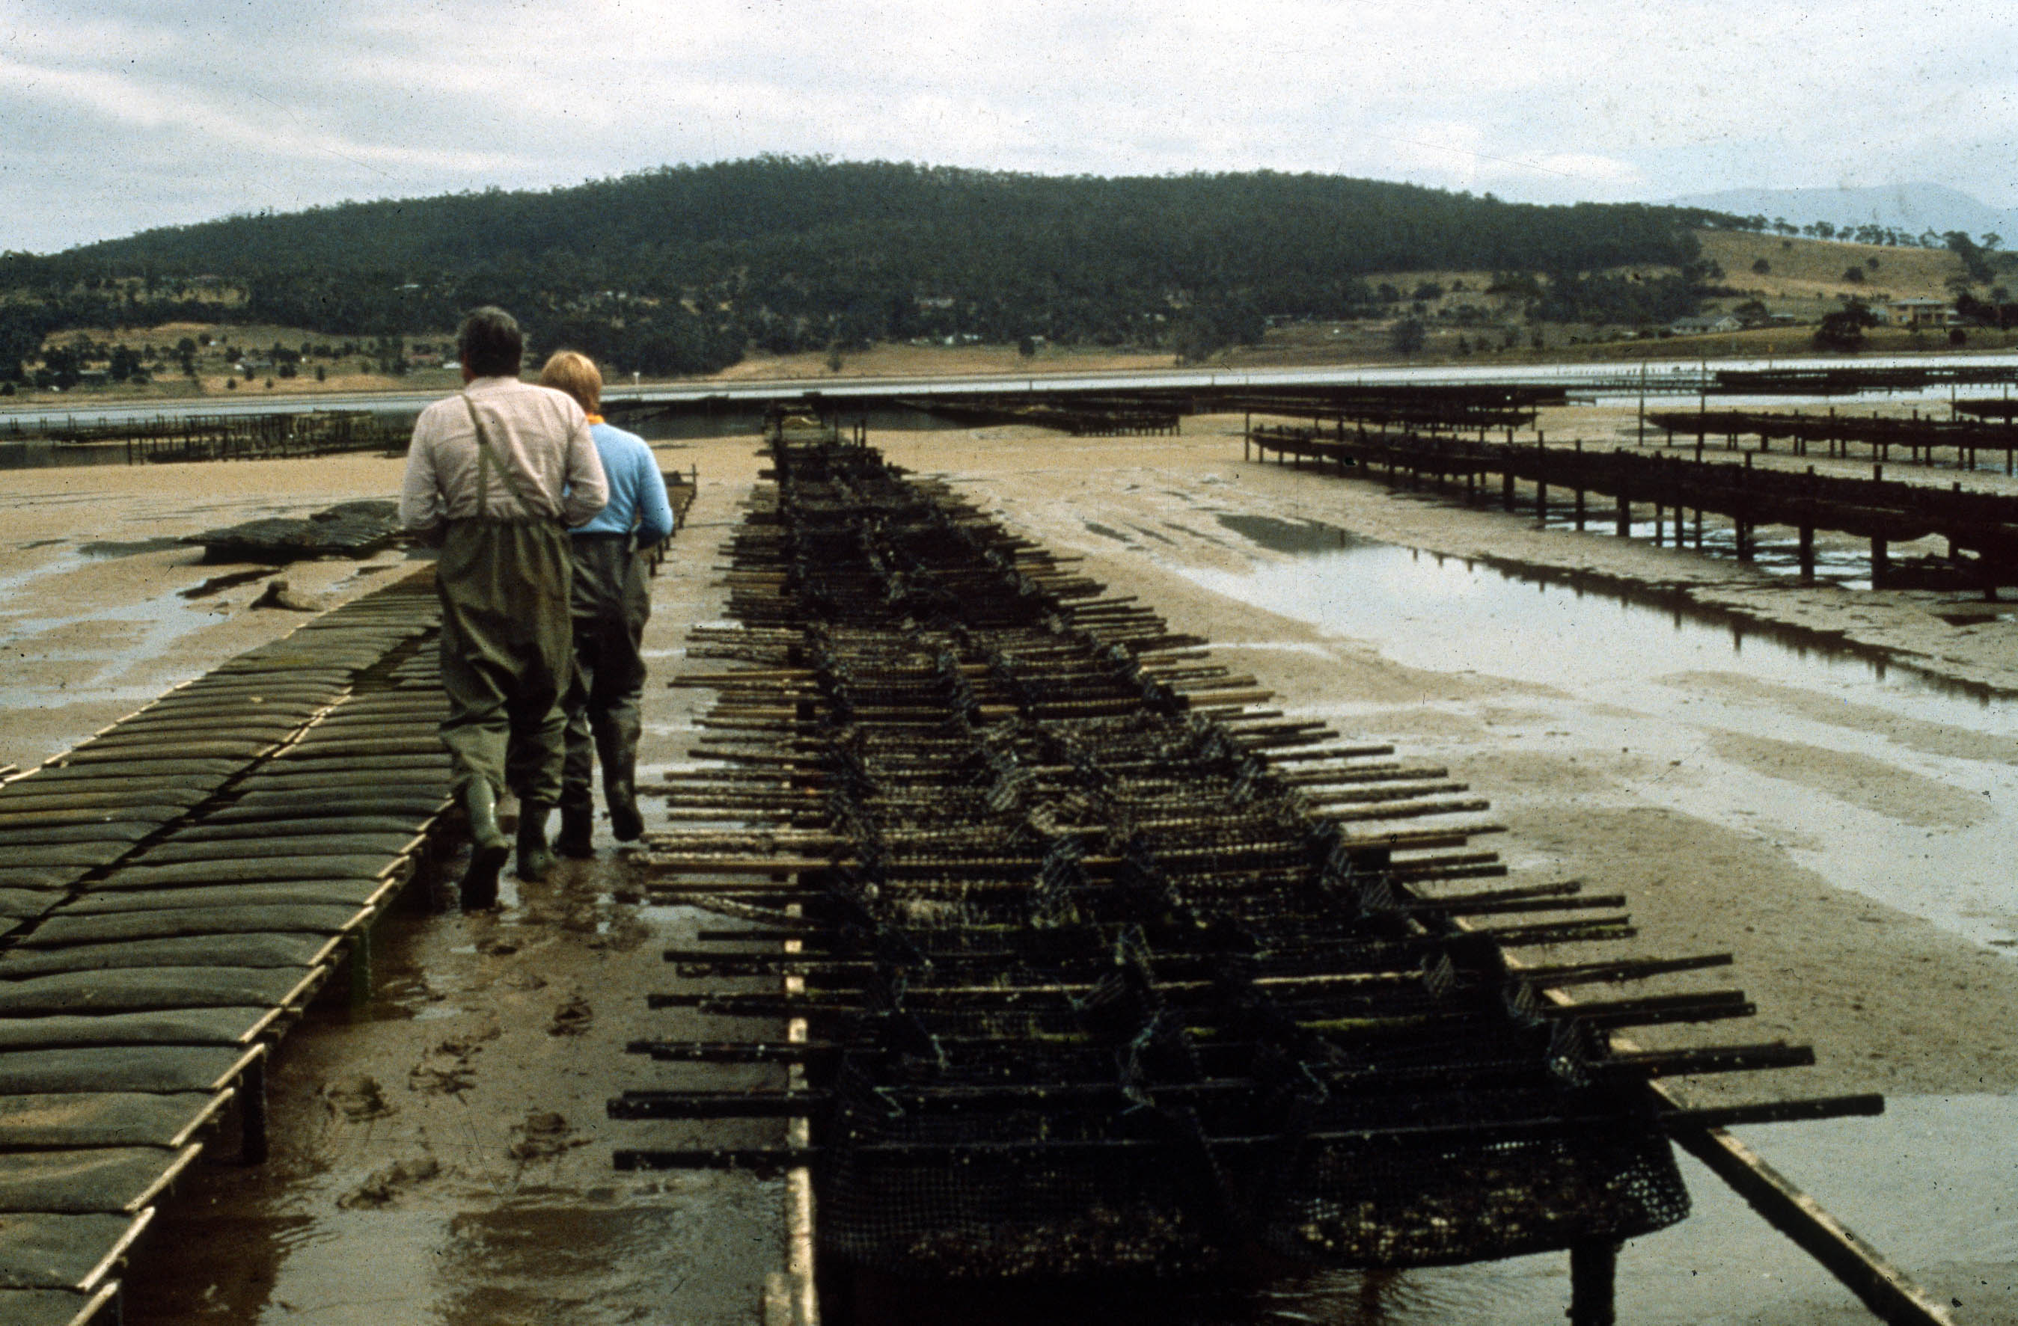

Slide 7
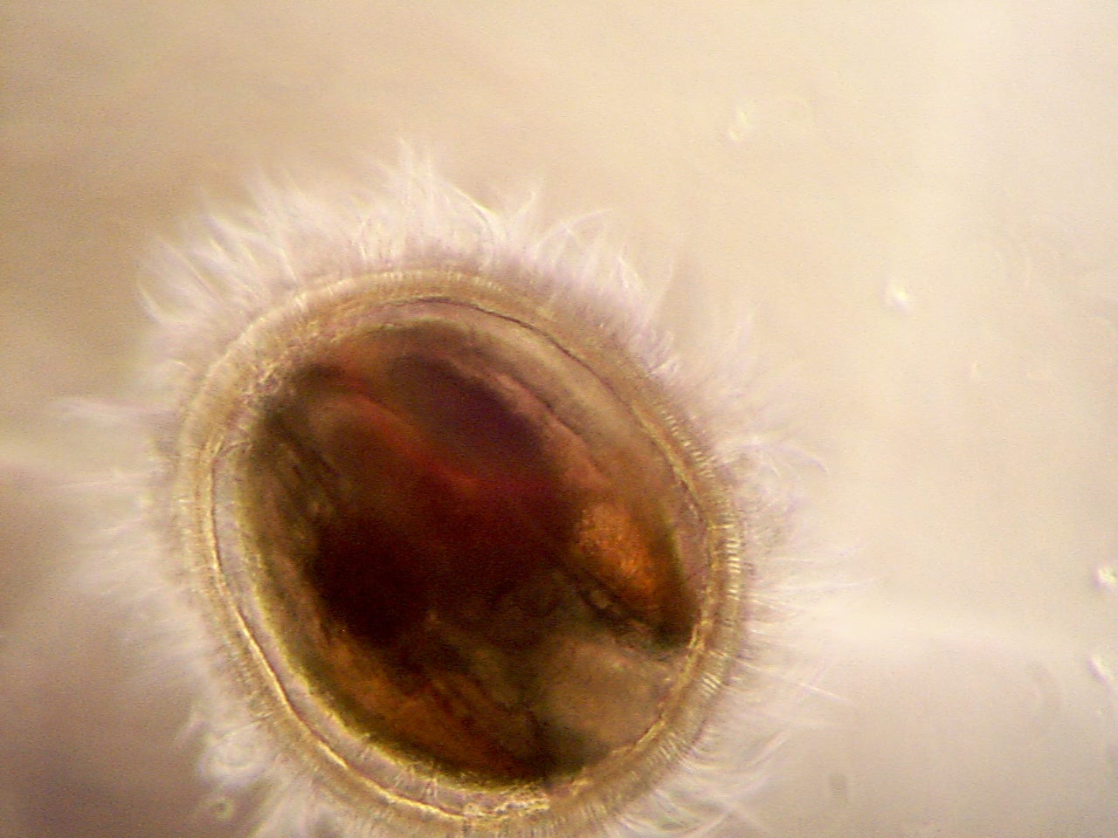

Slide 8
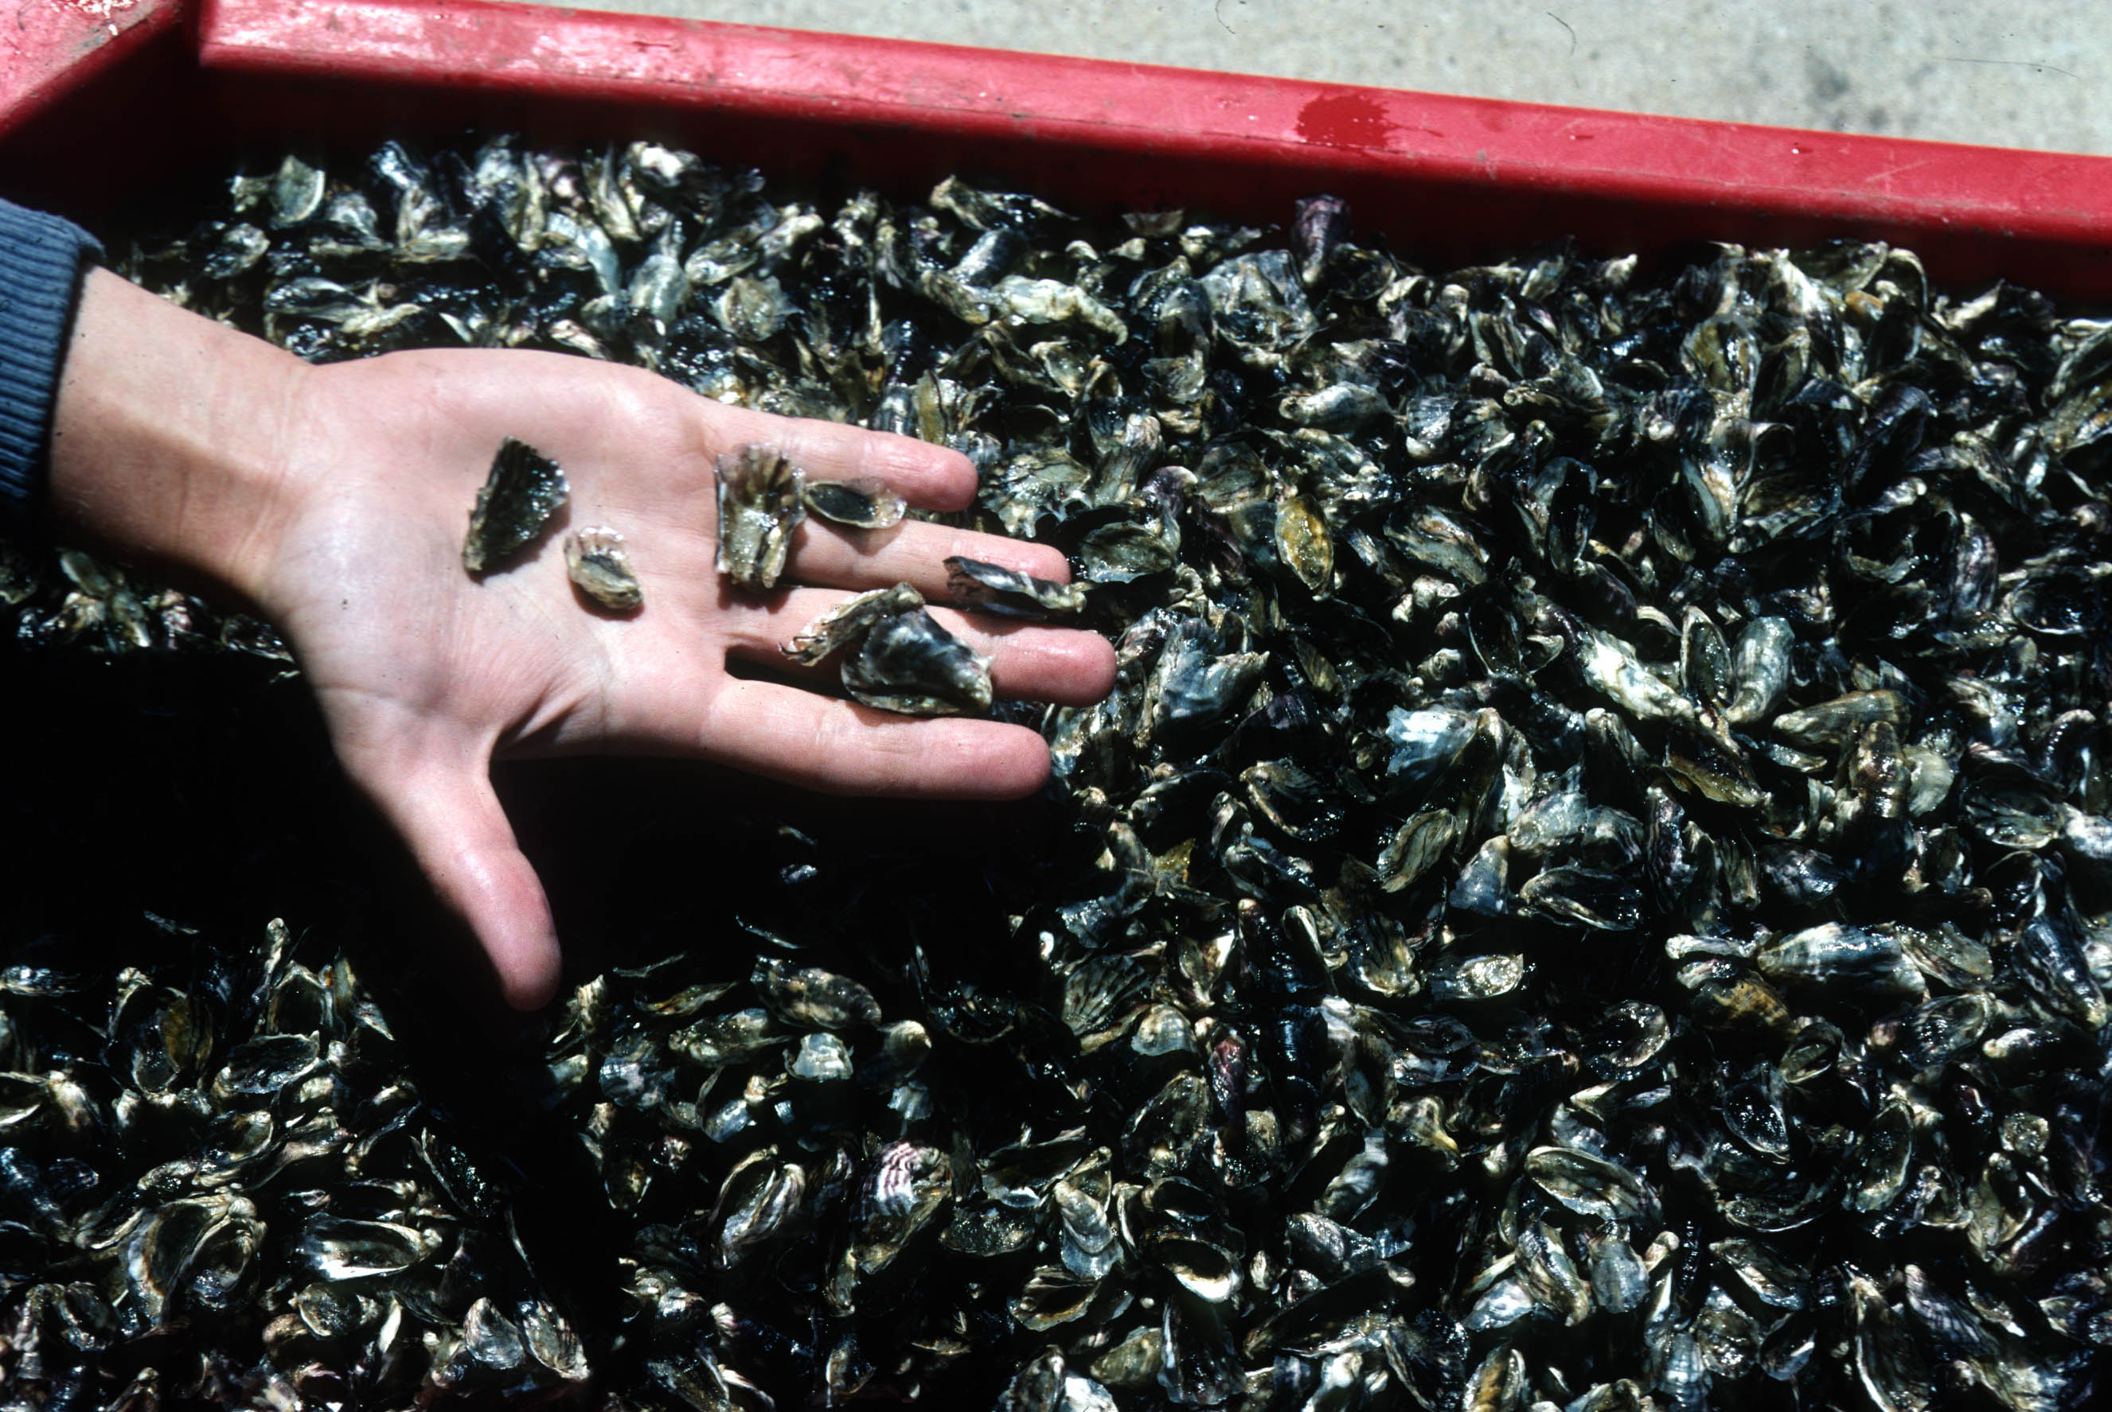

Slide 9
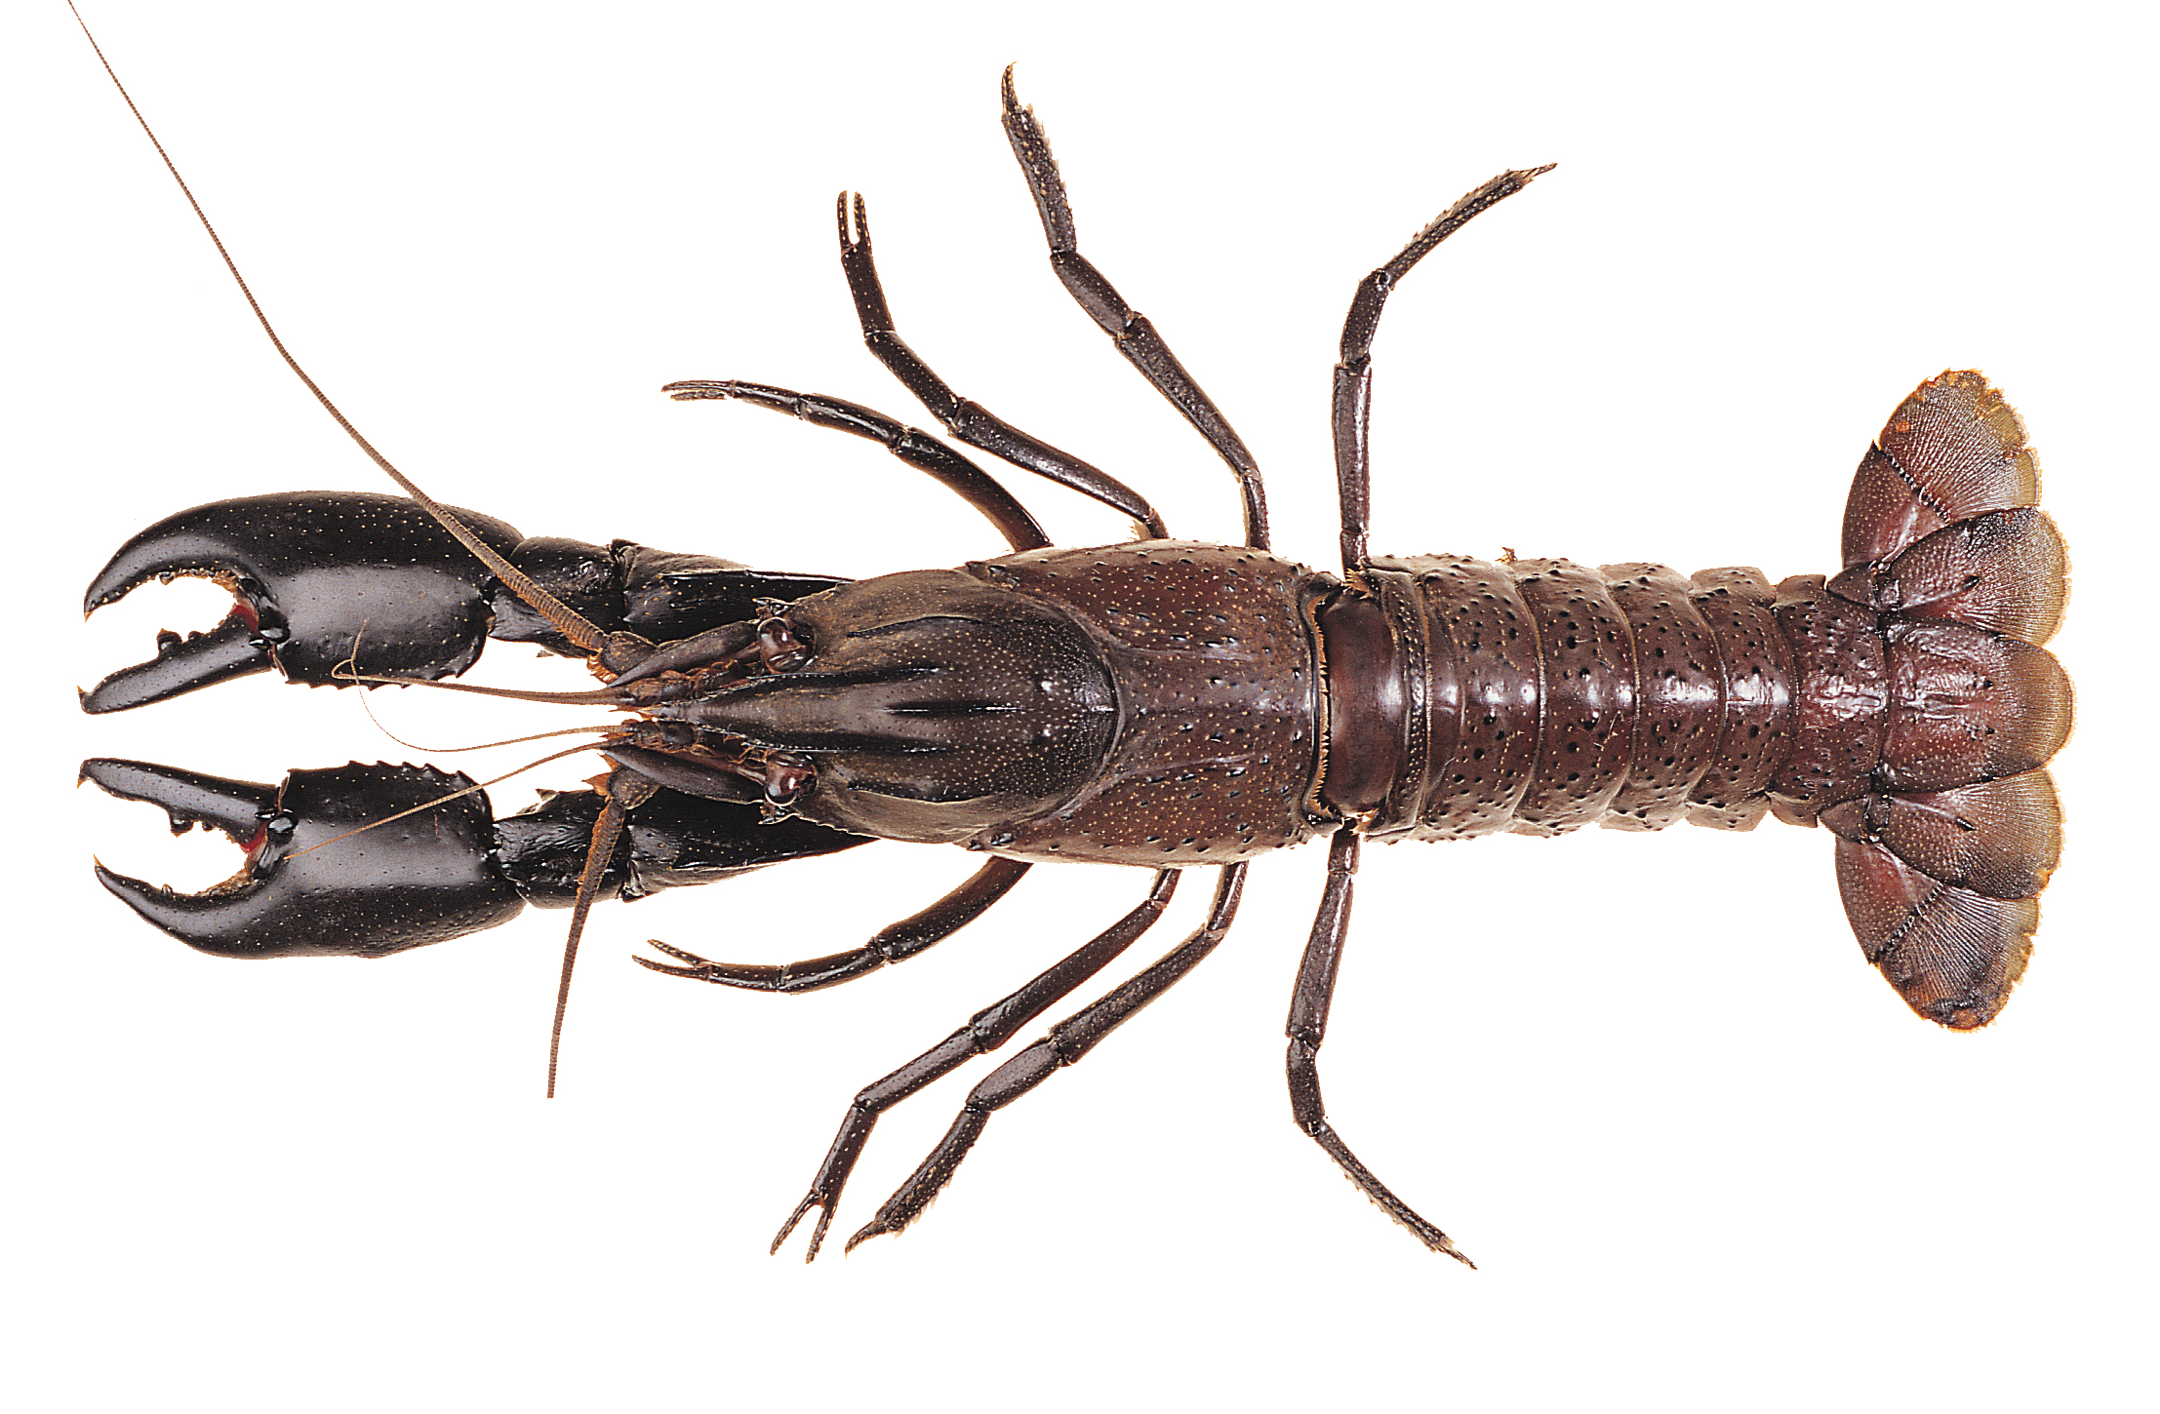

Slide 10
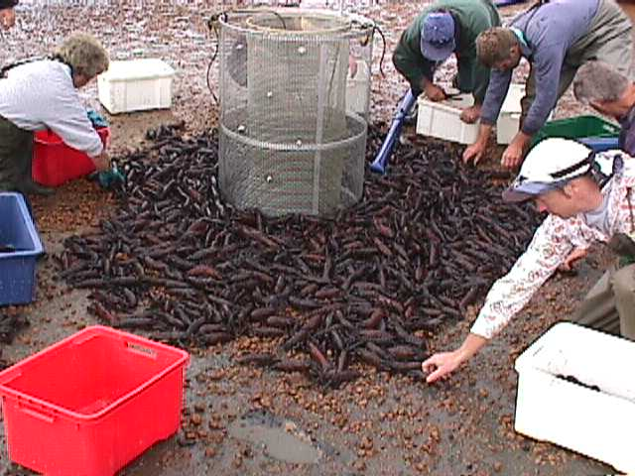

Slide 11
Research facilities
Relied heavily on using commercial facilities e.g., established an oyster & abalone research unit within a hatchery/growout farm in Tas. – it operated for about 6 years
Also used facilities within my employers’ research institutes.

Slide 12
Advantages of Industry collaboration
Access to their knowledge, resources & skills
Greater chance of adoption of results
Access to research funds (credibility)
They may suggest the topic
Build a relationship -> more grants!
Relationship spills over into employment of your University’s graduates.
Access for your research students/WE clients

Slide 13
Oyster Industry Tasmania (& S.A.)
Profitability studies (ABARE)
Triploid oysters
Tetraploid oysters
Selective breeding
Improved husbandry
Assisted with clam project (plus spinoff projects such as disease research)

Slide 14
Risks (across several industries)
Not interested in other demands on your time
May not respect commercial agreements
Parochial views can threaten a project
Overly keen/we know better (clams)
Errors by industry staff
Errors by research staff!
Blame the research staff

Slide 15
Risks (across several industries)
Conflict of interest: tuna/prawns
Can veto disclosure of information in a thesis.
Researchers can be inflexible (oysters).
Conversely, industry almost never interfered with planned research.
Researcher can be seen by his employer as an advocate for industry.
Can attract too many grants (too helpful).

Slide 16
Researcher needs to….
Consult & bring in research partners.
Be reliable & maintain high standards (pilot).
Communicate results in industry friendly form.
Be open to their advice but offer new ideas.
Respect them and earn respect.
Understand but stay out of industry politics.
Keep a close eye on hosted research students & research staff.

Slide 17
Was it worth it?
My 9 years at University of Tasmania was the most satisfying of my career (present job excepted!).
A very large part of that was due to my collaboration with industry.

Slide 18
The end!
Thanks for your interest.
Any questions?

