Slide 2
Emotional Comfort:
Patient Perspectives of a Therapeutic State
Associate Professor Anne Williams

Slide 3
“In all the wonderful work being done in the field of medicine and healing, there is one basic concept that is often dismissed as irrelevant. That is the relationship between the mind and the body, and the possibility that this relationship might have a direct effect on either our state of health or our ability to heal.”
(Shapiro, 1999, p. 1)

Slide 4
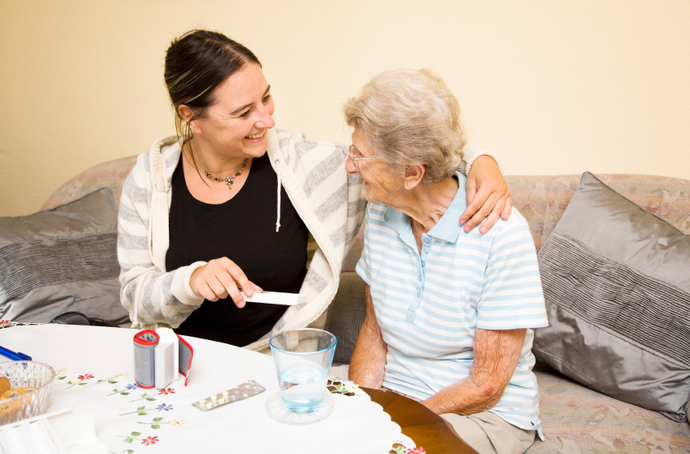
Background

Slide 5
Methodology
Method: Grounded Theory
Data: 72 (40+16+16) Patient Interviews and 78 Hours of Field Observations
Analysis: Constant Comparative Method
Data Management: QRS Nud*ist (4)
Sampling: Theoretical

Slide 6
A Substantive Theory
“Optimising Personal Control to Facilitate Emotional Comfort”
Personal Control: The ability of the patient to influence the level of comfort

Slide 7
EMOTIONAL COMFORT
A pleasant positive state of the mind, a state of relaxation
“… if you feel comfortable and good about it well obviously it’s going to help your healing ...” (Patient)

Slide 8
Conditions Facilitating Emotional Comfort
Feeling safe and secure
Feeling informed
Feeling valued as a person
Feeling connected to other people

Slide 9
A Therapeutic State
Mind-Body Connection
An increase in emotional comfort decreased physical
discomfort
The optimal state for recovery from illness or injury was Emotional Comfort.

Slide 10
Relaxation and Calmness
“It made me feel better, it just made me feel even more relaxed … I can’t describe it any other way. I just feel better … in here, in my heart” (P09)

Slide 11
Physical problems were less noticeable
“… the difference of course was that if you feel better within yourself … you don’t remember the down sides” (P31)
“… You don’t notice your aches and pains … you skip over it …” (P32)

Slide 12
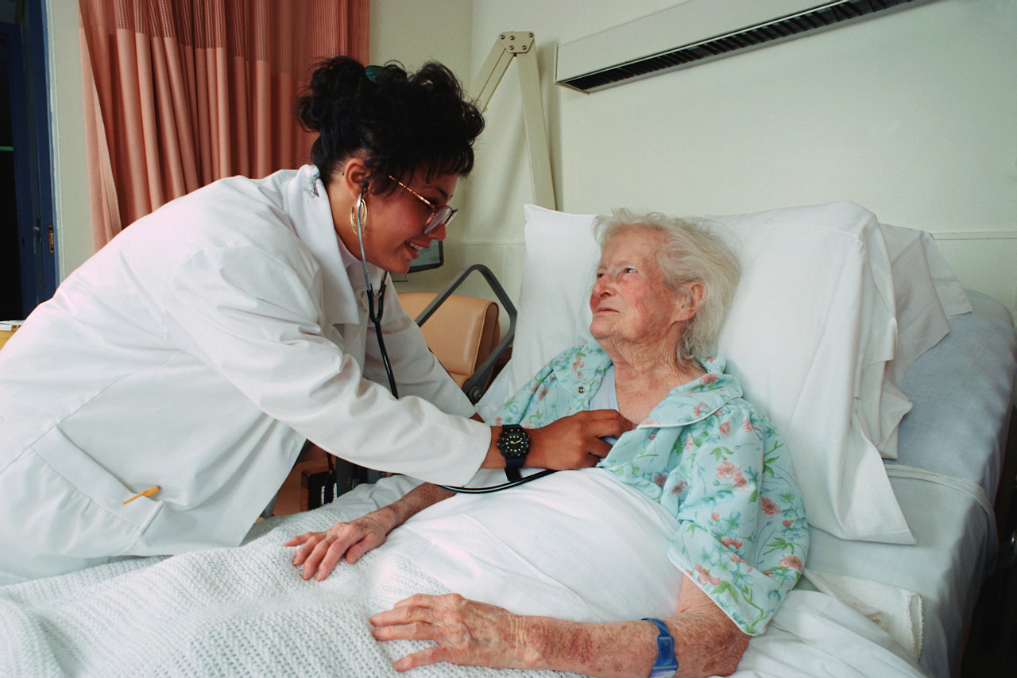
Creating a Therapeutic Environment
“I felt that the people at the hospital really knew how to support me and they knew how to make me feel relaxed. They created an environment in which I felt able to make a good recovery” (P12)

Slide 13
Future Directions
Further exploration of Emotional Comfort as a therapeutic state
Development of an instrument to measure Emotional Comfort
Development of interventions which facilitate Emotional Comfort.
Development of environments which promote Emotional Comfort.

Slide 14
Acknowledgements
Professor Vera Irurita
Professor Linda Kristjanson
SolarisCare Foundation
National Health and Medical Research Council
Department of Health, WA

