Slide 1
The search matrix -
the point from which something else develops
Lyn Leslie
Faculty Senior Librarian
Notes:
Hello and welcome. My name is Lyn Leslie and this is my topic. You may well ask, what is a search matrix?
A search matrix contains all the elements that you need to consider when developing your search strategy. The results of your search will help to formulate your research proposal and write your literature review.

Slide 2
I want to ...
Find this journal article
Get the full text of this item not held @ECU
Check for gaps in the literature, to suggest a thesis topic
Look for information on my topic
Manage my citations
Notes:
Put your hand up if you have ever wanted to do any of these things.
In today’s presentation I am going to show you some strategies for doing these types of searches – if you have questions, do not hesitate to ask as I work through the strategies.

Slide 3
To search for known items...
Use the Library Catalogue or
Library One Search
If the item is not held, then:
Request a book using, BONUS
Request a journal article using VDX (Virtual Document Exchange)
https://www.ecu.edu.au/centres/library-services/borrowing/borrow-from-a-non-ecu-library/other-libraries
Notes:
Use Library One Search to search a title and author in the same string and then limit with content type using the facets on the left. Journal articles can be searched by typing the title of the article and enclosing it in quote marks.

Slide 4
The ECU Library Catalogue
Click the tab to change the search option
My Library Record allows you to:
save searches to receive updates
manage your loans from home
Notes:
The Library catalogue lists all item in the collection, including print and online: books, journals, music, videos, including streamed video.

Slide 5
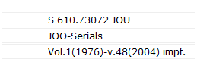
Journal record
Click for online full text – Note: only one source is current
Print holdings will be on a separate record and look like...
Notes:
Persistent link
Multiple holdings – note that this title is acquired through several online full text sources and only one is a current subscription

Slide 6
Book record
The campus location, shelf number and status
Notes:
BONUS
Persistent link
Request an item held on another campus or if it is on loan using the blue request button.
Location details

Slide 7
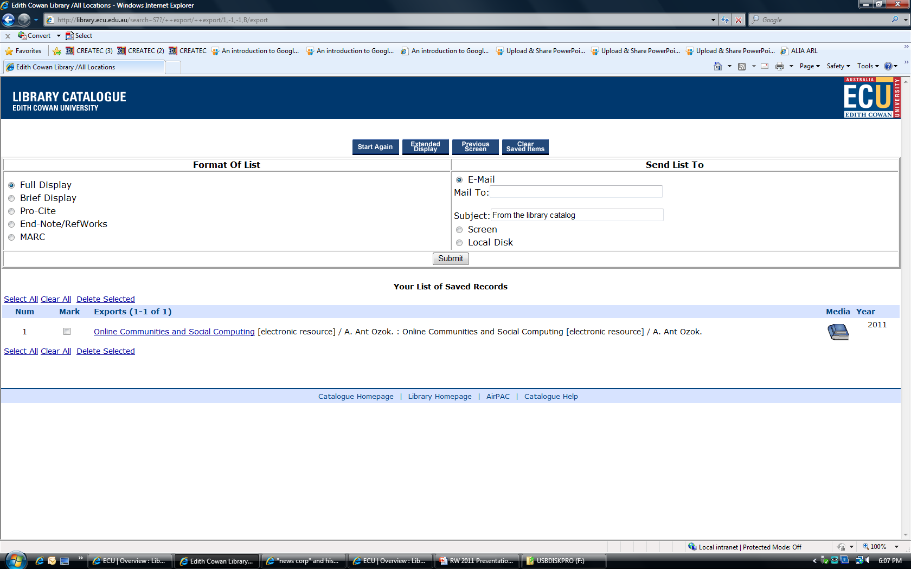
Save Results
1
2
Search, then click to mark and save marked records
Notes:
Still in the library catalogue
Screen 1
Do your search
Click to mark the required item/s
Click to save marked items
Click the top blue button to view saved records
Screen 2
Select all, clear or delete
Email or download
Submit
Delete selected once emailed

Slide 8
The Search Matrix
Literature Review
The topic
Concept map to identify gaps and terms
Search and Evaluation
Manage results and alerts
Notes:
I have talked about locating specific references and now I will elaborate on the process for finding information on a topic.
Matrix: something that constitutes the place or point from which something else originates, takes form, or develops
http://dictionary.reference.com/browse/matrix

Slide 9
...
Brainstorm the topic
Draw a concept map
Identify keywords
Develop some search strings
Notes:
It is always useful to brainstorm the topic, asking yourself what you already know, and identify areas that you may need to explore more fully.
Drawing a concept map often helps to give you a picture of each of the key areas of the topic. Here you should also include a section for the research methods that are being used as some discussion of these will be required in your literature review. When you have identified the key areas and identified some terms to describe each area, then you can begin to form some search strings. These can then be run quickly through a number of search tools to provide a picture of the literature and give you an idea of the best search tools. You can always modify your concept map as your searching proceeds.
Database thesaurus are also an aid to identifying terms
Use paper or free Open Source mind-mapping software such as Free Mind
http://freemind.sourceforge.net/wiki/index.php/Main_Page

Slide 10
Concept map example...
Topic: Prevention of obesity in children
prevention
sport
diet
obesity
overweight
Nutrition disorder
children
infants
schools
Notes:
Ask what might be missing? Maybe we need to further expand each section eg add games to sport or specific sports; add tuck shops, lunches or canteens to diet. Maybe body mass index to obesity.
When you begin searching, other terms may present.
Check out the EBSCO visual search under the search screen as this can assist with terms
Use paper or free Open Source mind-mapping software such as Free Mind http://freemind.sourceforge.net/wiki/index.php/Main_Page

Slide 11
Visual search example
Notes:
Visual searching from the EBSCO database can be useful to try when using one of their databases. It is not exhaustive and is a type of searching that can be useful when conceptualising a topic.

Slide 12
Develop search strings...
Obesity AND prevention AND children
Overweight AND diet AND schools
(canteens or tuck shops) AND schools AND obesity
Sport AND obesity AND prevention
Notes:
Once you have a few search strings then you can run them through a few search tools, modifying the search as you see the need.
Remember, AND between 2 words narrows the result as both terms have to be in it. OR broadens the result.

Slide 13
Where to search...
Library One Search
- a good place to begin
- a single search of the library’s collection
- narrow using the facets on the left
Databases
- have a thesaurus
-Can be subject focussed or multi-disciplinary
Subject Guides
- list available resources on broad subject area
Notes:
List Keywords / key concepts Related terms Broader/narrower terms/research methods/ check for gaps
For this example, I chose the CINAHL cumulative Index to Nursing and Allied Health Literature. Other suitable databases could have been Medline, or ERIC. There are databases representing most subject areas

Slide 14
Search Tool Location
Notes:
All are listed on the front of the Library website.
Subject Guides provide lists of databases applicable to an area.
On the right hand side of the library website, you will find access to:
The catalogue
Subject Guides
Databases
Document Delivery

Slide 15
Subject Guides...
Notes:
Subject guides bring resources on a broad subject area together in a single location.
Choose your subject area on the left and follow the prompts.
Alternatively, choose from the lists of popular and recent guides.

Slide 16
Research Guide
Notes:
The following can be located on the Research Subject Guide:
Sage Research Methods database
Research level databases: Web of Science, Scopus,
Cross Ref to check for journal DOIs, as they are required when using the APA 6th ed
and how to get an ISSBN, ISSN for your publication
Contacts
Also, note the theses tab....

Slide 17
Searching other research
Notes:
This tab provides information about how to access other theses. Australian theses can be accessed through the National Library using TROVE or Libraries Australia.
ECU these are listed in the library catalogue and in ECU Research Online.

Slide 18
Database Search Tips
Start specific, one word searches are useful to test a database
To search as phrase, enclose terms in “ ”
AND between 2 keyword narrows the search
OR broadens AND NOT excludes terms
Use truncation to search for variations of the stem word i.e. Austral* finds Australia Australians and wom?n finds women, woman
Check each database HELP for symbols used

Slide 19
Library One Search
Notes:
Enter your search string in the search box

Slide 20
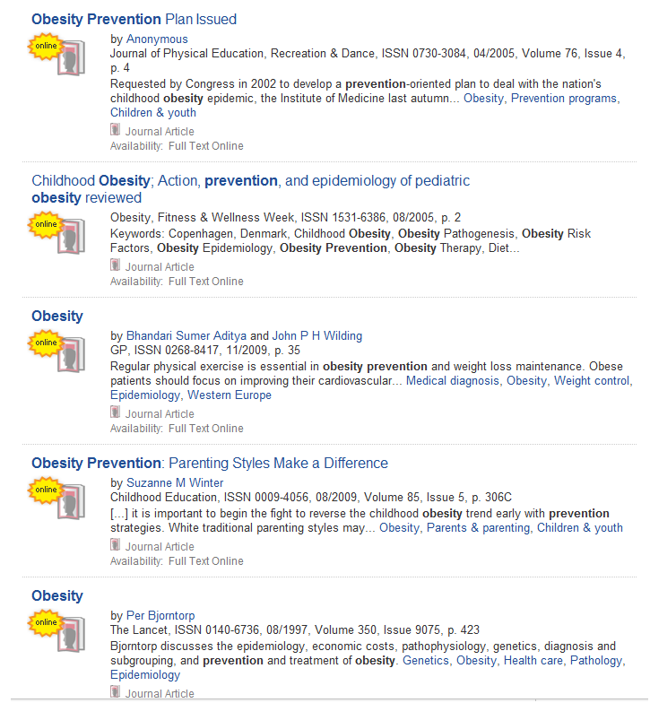
Library One Search
Notes:
Choose facets on the left to narrow your search i.e. content type, other subject terms and scholarly publications
Hover the mouse over the title or the top right of the entry and click on the magnifying glass to see an abstract of the article
Click the + sign on the right to save records to a temporary folder at the bottom of the screen
Click on the title to access the library catalogue for print collection locations or full text of the article
Click the ECU symbol on the top left of the page to return to the home page.

Slide 21
Saved search folder
Notes:
The saved search folder in Library One Search allows you to:
Select the referencing style
Transfer the items direct to EndNote (have your EndNote Library open on the bottom tool bar.)
Email or print the items – email allows you to retain the link for access.

Slide 22
Databases...
Access using:
the A-Z title list or the subject guide
Coverage:
Broad subject area or multidisciplinary
Provide thesaurus to assist with terms
Sign in if to save searches and receive alerts
Notes:
Databases: There are top level databases for various areas that focus on research:
Web of Science, Scopus, Medline, Science Direct, IEEE (Engineering), PsycINFO, CINAHL, A+ Education

Slide 23
CINAHL Thesaurus
Notes:
An example of a thesaurus expanding the list of terms available

Slide 24
The search screen...
Notes:
Enter your search and select from the limits below the search box. Most databases will offer options to limit your search.

Slide 25
Search results...
Sign in to save items in folder, save searches and to set up search alerts
Click PDF For full text
Click title for full record
Notes:
Side facets on the left for refining the search

Slide 26
Find @ ECU Option
Notes:
Provides the options to get the article, or search the library catalogue or contact the library if access is a problem

Slide 27
Analysing credence…
Search for scholarly articles ( includes peer review)
Some databases list the times an article is cited by other articles in the database
JCR database measures impact of journals indexed in ISI Web of Science
Scopus has its own measure
Notes:
Peer reviewed articles have been vetted.
Most databases provide the option to limit to peer reviewed articles or scholarly journals.
Ulrich’s web is a database that can be checked to verify peer reviewed –if the journal is listed
Some databases give the number of times an article has been cited: Web of Science, Scopus, CINAHL
JCR will list the impact factor of a journal

Slide 28
Citation Management Alerts/EndNote
Create an EndNote Library:
to manage your references
to create bibliographies in a selected style
to create in-text references and a reference list
http://www.ecu.edu.au/centres/library-services/workshops-and-training/referencing/endnote
Notes:
For more information, check the website and the Workshops page for tutorials or contact your faculty/subject librarian

Slide 29
Thankyou
Lyn Leslie
Faculty Senior Librarian CHS
Notes:
Remember to contact your faculty/subject librarian if you need further assistance on anything I have talked about today,

