Slide 1
End-of-life Decision-making in Critical Care: minimising the suffering
Deborah Sundin
School of Nursing and Midwifery

Slide 2
End-of-life Decision-making in Critical Care:
Minimising the suffering
Deborah Sundin
School of Nursing and Midwifery

Slide 3
Background
History & the problem
Aim
Investigate interactions around end-of-life (ELD) making in Critical Care with a view to developing strategies which minimize the associated avoidable suffering for the decision-makers

Slide 4
Suffering is
Ubiquitous
Subjective
‘Part of the universal human experience
(Travelbee, 1971;Cassell, 1991; Younger, 1995; Pollard, 2002).

Slide 5
Avoidable suffering
Suffering related to those negative aspects of an experience which are predictable and might therefore be mitigated or avoided through the planning, development and use of appropriate strategies.

Slide 6
The Question
“How might avoidable suffering related to the process of decision-making that accompanies the implementation, maintenance or withdrawal of life-sustaining treatment in the critical care environment be ameliorated?”

Slide 7
Methodology
Critical Interactionism (Sundin-Huard & Fahy, 2004)
Adaptation of Interpretive Interactionism
- Epiphanies -
(Denzin, 1989, 1992)

Slide 8
Design
Data gathered from
Families, Nurses, Doctors
Process
Semi–structured interviews
Narratives
key decision-making moments
Interactions / absences/ constraints/ structures

Slide 9
Analysis
Examined Interactions around ELDs:
Identified key factors (contextual, personal, interactional)
Factors ordered/ sorted
In fewer than 3 of cohort stories – discarded
Subsumed where appropriate
Organised in process (i.e. where suffering minimised or maximised)

Slide 10
Defined key factors as:
Personal
Used when referring to intrapersonal, biographical, gender, race and class related factors that impact the interactions
Contextual
The micro and the macro organisational, and broader political factors potentially impinging on the interactional situation.
Interactional process factors
Used when referring to factors/ aspects of “… the interaction itself” (Denzin 1992, p. 39).

Slide 11
Contextual factors (Families)
Waiting area: public
Seniority of contact person: junior
Venue for decision-making: public
Intra-family agreement R/T ELD wishes: low
Impact negatively upon the interactive process

Slide 12
Personal factors (families)
Worrying: high
Feeling dazed: high
Feeling powerless: high
Not knowing or understanding: high
Feeling unsupported: high
Being unsure of loved one’s wishes re ELD: high
Not trusting: high
Ability to meet basic needs: absent
Impact negatively upon the interactive process

Slide 13
Process (Families)
Waiting for news: long
Being orientated: absent
Being separated (from loved one): long
Being supported: absent
Being ‘Kept in the Loop’: absent
Need to access informal information channels: high
Liaison between family and staff: absent
Offered inclusion in decision-making: absent
Sharing in decision-making: absent
Being supported in decision-making: absent
↓
High levels of avoidable suffering

Slide 14
Contextual factors (Nurses)
Clinical Severity: Moderate/ Indeterminate
Perceived prognosis: uncertain
Decisional urgency: very high
Medical Decision R/T ELD: not discussed or clearly documented
Congruence between DNR and continued ‘High-level’ treatment: absent
Relevant and Clear policy R/T DNR: absent
↓
Impact negatively on interactive process

Slide 15
Process (Nurses)
Decisional Input : not invited or offered
Discussing concerns : absent
Family Hostessing : absent
Collegial Support : absent
↓
High levels of avoidable suffering

Slide 16
Contextual factors (Doctors)
Clinical Severity: Moderate/ indeterminate
Perceived prognosis: Uncertain
Decisional urgency: Very High
Clarity of clinical situation: Obscure
Relevant, clear policy R/T to situation: Absent
↓
Impact negatively on interactive process

Slide 17
Personal factors (Doctors)
Level of seniority: Low
Personal Responsibility: High
Medical fear: High
Internal conflict: High
Values congruence: Low
Commitment to consensus building: Absent
Commitment to collegial reciprocity: Absent
↓
Impact negatively on interactive process

Slide 18
Process (Doctors)
Interactional engagement: Low/ Absent
Quality of interaction: Very poor
Active agency: Very high
Shared decision-making: Absent
Collegial support: Absent
Opportunity to debrief: Absent
↓
High levels of avoidable suffering

Slide 19
Family members
Tendency for family members to be:
‘overwhelmed’ by the trajectory of their loved one’s illness and the need for decision-making
and yet to be sure
of “what their loved ones would have wanted”

Slide 20
Nurses
Need to be:
Included
Respected/ considered
In the decision-making process:

Slide 21
Doctors
Burden of Responsibility:
But, I’ve still got to make my peace with my maker eventually. No one talks to us about it, ever. We get zero debriefing…That’s what I want, someone who understands, someone I can talk to.

Slide 22
And yet
Communication/ sharing of information
Nurse – Doctor
Nurse – Relative
Doctor –Relative
Was sparse, and sometimes lacking in ‘tact’.

Slide 23
Nurse-Doctor
So I was basically saying, "You're going to have to make a decision - are you going to let this lady go peacefully with her family there - which is important to them - or are you going to invade her body with all the things that you do?"

Slide 24
Doctor-Relative
Then this other Neuro guy came in and did obviously the same tests but he said, “I’m sorry he’s failed the exams - at this stage he’s brain dead.”

Slide 25
Thesis
the current practices related to end-of-life decision making in the critical care environment produces avoidable and unnecessary suffering for patients and families, nurses and doctors AND
that the amelioration of avoidable suffering in the critical care environment related to end-of-life decision-making requires policy and procedural changes at the organisational level

Slide 26
Model

Slide 27
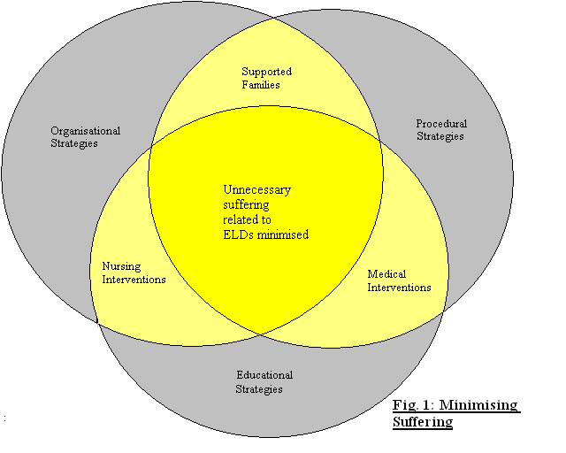
All relatives should be Oriented to ICU
Should not wait more that 10 mins for initial
contact with clinical staff
Family & all clinical staff significantly
involved should be invited to participate in
ELD-making
regular ‘sit down’ case discussions
All ELD’s should be clearly documented
Ditto DNRs

Slide 28
Private dedicated rooms - waiting/ resting
- discussions
Liaison nurse/s
Formal debriefing structure for clinical staff
‘Organisational structure’ flow chart : for
referral options when concerned
Once documented DNR → move to private room
Policy support for debriefing & ‘sit down’
Discussions
Clearly documented clinical & procedural policies
Minister of religion/ pastoral care be present
during withdrawal of care

Slide 29
Education in inter & intra personal communication
at undergrad & post grad levels of health professionals’
Curricula
Incorporating learning experiences (scenario
– driven) R/T ELD’s and giving bad news
All CC staff should be workshopped through
ELD scenarios at orientation and throughout the year.

Slide 30
Questions?

Slide 31
References
Denzin, N., Ethnography. 1992.
Denzin, N., Interpretive Ethnography. 1997, Thousand Oaks: Sage. 323.
Hauerwaus, S. (1979). Reflections on suffering, death and medicine. Ethics in Science and Medicine, 6, 229- 237.
Kincheloe, J.L. and P.L. McLaren, Rethinking critical theory and qualitative research, in Handbook of qualitative research, D.N. K and L.Y. S, Editors. 1994, Sage: California. p. 138-157
Rushton, C.H. (1992). Care-giver suffering in critical care nursing. Heart & Lung, 21(3), 303-306.
Younger, J.B. (1995). The alienation of the sufferer. Advances in Nursing Science, 17(4), 53-72.
Cassell, E.J. (1991). The importance of understanding suffering for clinical ethics. Journal of Clinical Ethics, 2(2), 81-2.

