Slide 1
Digital Tools For Research
Marziya Mohammedali & Silvia Torezani

Slide 3
Research: Then and Now
‘Just Google It, She Said’ (Terence Murphy)
Comparison of tasks associated with research, then and now
Easier
Faster
‘Who Stole My Idea?’ (Ken Gasmier)
Access to current research helps you know where you stand
Different perspectives

Slide 4
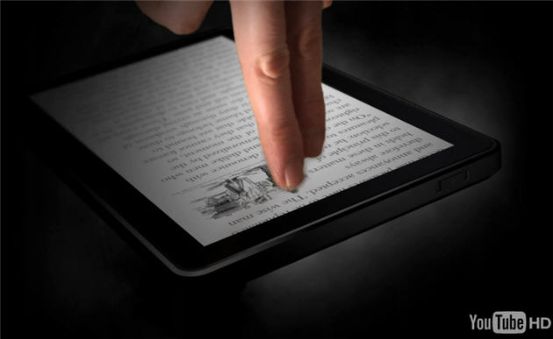
Mobile Devices

Slide 5
Mobile Devices
Portable
Connectivity
Space
Data Storage
Less obtrusive
Increasing functionality – Apps
All-in-one features (camera, soft keyboards)

Slide 6
Mobile Devices
Some useful apps are:
Evernote – text, audio notes, syncing with other devices
SoundPaper – records sound as you type, links audio and text
Notify – records sound, links audio and text
iThoughtsHD – visual mapping
IdeaSketch – visual mapping
Papers – find, download, tag papers
GoodReader – document reader
iAnnotate – annotate documents
Dropbox – sync files; share with collborators
Pulse – RSS feed reader

Slide 7
Conferencing software
Allows for remote communication:
Researcher and interviewees
Collaborators
Candidate and Supervisor
Examples include:
Adobe Connect Pro
Scopia
Skype
FaceTime (Mac)

Slide 8
Bibliographic software
EndNote – not just for referencing, can also store PDF files
Zotero
Mendeley

Slide 9
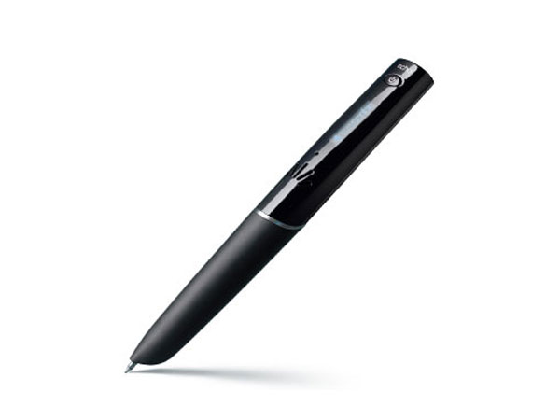
Recording devices
Particularly useful when gathering data:
Thoughts
Observations
Conversations
Interviews
Presentations
Some tools are:
Digital recorders
iPod recorders
Smartpens (LiveScribe)

Slide 10
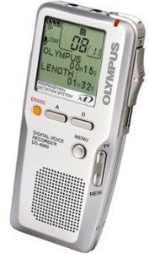
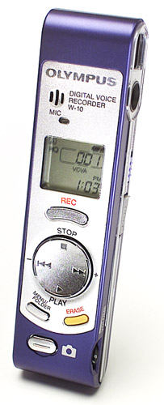
Digital Recorders
Prices: $60 - $250
Availiable from soters such us OfficeWorks, DickSmith or via Online Shopping (eg. Amazon.com)
http://dicksmith.com.au/dsau/search/dsau_search_results.jsp
Digital (USB), not tape!
Platform compatibility (Mac, PC)
Battery time, GB memory size and Recording Hours
M34 and WMA

Slide 11
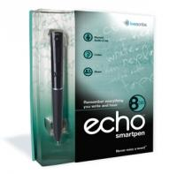
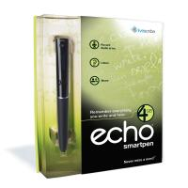
SmartPen
Prices: $99 - $299
Latest Model: Echo; 2 sizes (4 and 8 GB); Previous Model: Pulse (2 GB)
File synchronisation across devices and applications (mobile and desktop)
Record while backing up (hardcopy, desktop and online)
Documenting and organising research and meeting notes
Voice to text synchronisation.
http://www.smartpen.com.au
$299
8GB
$199
4GB

Slide 12
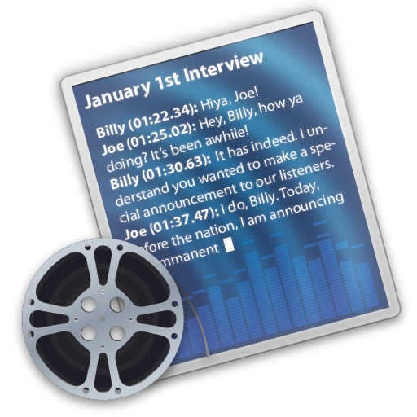
Transcribing
Express Scribe (Free Download
http://www.youtube.com/watch?v=Zseqeu-mAJw
Transcriva ($30)
http://www.bartastechnologies.com/products/transcriva/

