Slide 1

The 3-Year Fast-Track PhD
Dr Terence Love
t.love@ecu.edu.au

Slide 2
Aims for PhDs
Candidates with doctoral competencies
All doctoral completions within 3 years
High-quality doctoral outcomes useful to society
Same outcomes for 2nd-language speakers

Slide 3
Public concerns
Lack of useful PhD outcomes to society
Worth less than cost to society (~$500,000/PhD)
Poor completion rate (60% - but near 100% for those that submit)
Overrun of time
New doctors not competent or useful to society

Slide 4
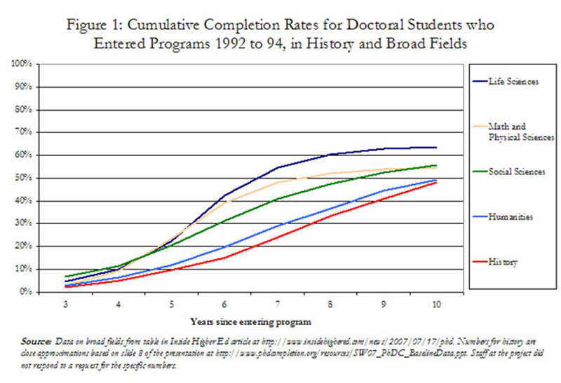
Completion rates

Slide 5
Background
Work study of PhD research, supervision & examination (tasks, time, critical paths, lost time)
Research literature – PhD study, supervision, education, assessment…
Educational theory - aims, objectives, curricula, learning objectives, performance criteria, assessment modes ..
Empirical observation and testing…

Slide 6
Candidates’ concerns
Am I good enough?
Is my research really a PhD?
Have I reviewed enough literature?
Are my research methods and analyses ok?
How can I write such a big thesis?
I don’t feel like a doctor!
How do I learn professional doctoral skills?
Will I want to do this for all those years?
Is my language good enough?
How can I complete within time?

Slide 7
What delays PhDs?
Administration delays and errors
Wrong kind of research project
Faulty time plan
Unstructured literature review process (serendipity etc)
Unstructured/late thesis writing and thesis structure
Reasoning and justification problems
Personal crises
Student skills (reasoning, writing, perspective)
Unhelpful/contradictory guidance by supervisors

Slide 8
3 Year PhD Time-line
Task | Time
Application | 1 month
Candidacy and ethics approved | 4 months
Literature review & data collection prep | 5 months
Data collection | 4 months
Analyses | 5 months
Contingency & personal crises | 2 months
Holidays | 3 months (4 week/year)
Proofing and editing of thesis | 6 months
Examination and award | 5 months
Total | 36 months ( 3 years)

Slide 9
Fast-Track Supervision
Weekly meetings with student (48/year)
Proofreading candidature/ethics
Supervisor always knows more than student
Pastoral care
Face-to-face training in writing, research methods & doctoral attributes from week 1
Candidacy and thesis writing from week 1
Proof reading thesis from week 1

Slide 10
PhD competencies
Set up and manage new research projects
Develop new research and theory (different from their PhD)
High level reasoning skills
Collaborate effectively in a variety of team roles
Good team worker
Sound administrator
Accurate and honest budget management
Develop quotes for work and plan workflows and resources
Write professional documents and reports that will stand legal scrutiny
Manage their personal and work lives professionally
Establish and maintain professional networks
Make sound professional and ethical judgments
Be politically and administratively effective

Slide 11
Types of Research Project
Problem-based research (usually best for PhDs)
Single question research (Why did the Egyptians to build pyramids? – often unsuitable)
Blue-sky research (‘What happens if…? - usually not suitable for PhDs)
Hypothesis-testing research (only for fields with highly-developed and tested body of theory)

Slide 12
Reasoning &
Justification
Logical (If A true and B is true then logically C )
Casuistic (e.g. because a trusted researcher reported it on the basis of their research)
Deontic (self-evident, e.g a cup is a cup)
Rhetoric (persuasion through emotion or fallacies. Usually important to avoid using rhetorical justification in PhD theses)

Slide 13
Structured lit. review
A common fear of PhD candidates is ‘How do I know if I’ve reviewed enough material?’
Simple structured literature review method (for Google):
  Set Google Preferences - 50 items (scrolls faster)
  Identify and write down appropriate ‘keywords’ to search
  Google using these keywords and identify better keywords (by reading titles, abstracts, and exec summaries)
  Repeat until no longer useful and then use for search
  Review and save relevant documents and copy details into Endnote
  In literature review, describe and justify choice of keywords before reviewing material
Use similar process for library catalogues, journals, databases etc.

Slide 14
Structured thesis
Too much effort and time goes into re-organising and re-writing PhD theses.
Start writing thesis week 1 (with supervisor proof reading)
Use pre-defined thesis structure of limited size
Recommend Perry ‘5 Chapter Thesis’.
75000-80000 words (less words is better)

Slide 15
Perry 5 Ch Thesis
Structure approved by examiners
Written in shortest time with minimum content
Demonstrates doctoral competencies
Parts suitable for publication (thesis)

Slide 16
5 Ch process
Define research problem
Review literature - how others have tried to solve research problem
Identify research questions that provide information to resolve research problem
Choose methods of data collection and analysis to answer research questions
Report Results of data collection
Explain how Results answer research questions and solve research problem
Explain implications

Slide 17
5 Ch Structure
Ch 1 - Introduction
Ch 2 - Literature Review
Ch 3 - Research Methods
Ch 4 - Report of Data Collection
Ch 5 - Conclusions & Implications
References
Appendices

Slide 18
Administration issues
Administration is consistently one of the unnecessary causes of delay in PhD completion
Manage administration timing tightly, and
Manage your supervisor managing administration

Slide 19
Timeline 18 month PhD
(very experienced researchers only!)
Task | Time
Application | 1 month
Candidacy and ethics approved | 2 months
Literature review & data collection prep | 2 months
Data collection | 2 months
Analyses | 3 months
Proofing and editing of thesis 70,000 words | 5 months
Examination and award | 3 months
Total | 18 months

Slide 20
Discussion
‘Best practices’ supervision
Choice of research project
Timeline
Personal development of candidate
Doctoral competencies
Structured literature review and thesis
The best way to learn reasoning, research methods & writing?
High-level PhD administration by supervisors

Slide 21
Questions?
Contact details:
Dr Terence Love
t.love@ecu.edu.au

Slide 22
Feedback?
Please complete the feedback sheets.
Leave in pile by exit

