Slide 1
Capturing the Cape
A Photographic Case Study of the Cape Range Bioregion of Northwest Australia
David Jo Bradley
K36 Honours Research Presentation

Slide 2
Capturing the Cape: David Jo Bradley
Aims of Research
Photographically document the four main landscapes of the Cape Range Sub-Bioregion:
Town of Exmouth
Cape Range National Park
Ningaloo Marine Park
Harold E. Holt Communications Base
Contribute to future relationships between locals and the environment
Offering a more complete depiction of the area as a bioregion
Notes:
Exmouth: Inhabited Area
Cape Range: Pristine Wilderness
Ningaloo: Pristine Wilderness
Harold Holt: Ruined Industrial

Slide 3
Capturing the Cape: David Jo Bradley
Significance
A need to adapt the way humans view the bioregions they live in
Mounting evidence suggests human activity is the biggest contributor to climate change
“All known natural explanations for the current global warming trend have been eliminated by direct observations.”
(Wang and Chameides, 2007, p. 6)
It is necessary for humans to understand the need for a cultural shift in how we perceive the environment.
Notes:
Bioregion Definition: A region that sustains life, where people both live and work.
Key point: natural explanations have been largely ruled out.
Given this, it’s necessary for humans to understand the need for a shift in how we view the environment

Slide 4
Capturing the Cape: David Jo Bradley
Significance cont…
Photography with a comprehensive depiction of a bioregion can contribute to a cultural and practical shift
“Recent history suggests that photographs have the ability to influence our perceptions of land and consequently influence the ways we engage with it”
(Tolonen, 2012, p. 21)
Instead of ecology concerned with protecting some environments while exploiting others, a more sustainable approach of appreciation for all environments in a bioregion is need.
Notes:
A photo project like mine can contribute to this cultural and practical shift
Mostly because it offers a different perspective
One that is more sustainable than the current one
Which is devoted to protecting some environments and exploiting others
I argue an outlook that appreciates all environments, both spoiled and unspoiled is needed is more sustainable

Slide 5
Capturing the Cape: David Jo Bradley
Theoretical Framework
Cultural studies of American and Australian landscape photography
Rod Giblett
Living With the Earth: Mastery to Mutuality (2004)
Sublime Communication Technologies (2008)
People and Places of Nature and Culture (2011)
Photography & Landscape (2012)
Juha Tolonen
Waste*lands: Landscape photography modernity (2007)
Photography & Landscape (2012)
Helen Ennis
Intersections: photography, history & the national library of Australia (2004)
Photography & Australia (2007)
Notes:
Three Key Sections of Framework:
Photographic Conventions: the Sublime, the Picturesque the Beautiful
Traditions of Australian Photography
3. Photography for environmental sustainability

Slide 6
Capturing the Cape: David Jo Bradley
Theoretical Framework cont…
Photographic Conventions: the Sublime, the Picturesque the Beautiful
Traditional landscape photography in America and Australia typically depicted the environment in one of two ways
The Sublime;
Awe-inspiring, monumental and reverent scenes of natural wonder
The Picturesque;
Appealingly arranged, often tamed landscapes
These conventions continue to resonate through contemporary photography
Notes:
Giblett informs the sublime and the picturesque
Ennis is more concerned with the picturesque
The Beautiful appears less so
These conventions continue to influence the landscape photography we see today

Slide 7
Capturing the Cape: David Jo Bradley
Theoretical Framework cont…
Traditions of Australian Photography
Australian landscape photography employs aesthetics drawn from traditional American landscape photography and European landscape painting.
These European and American depictions of nature have established a deeply entrenched attitude of mastery over the environment
“The aesthetic modes of the sublime and the picturesque are used across all three without regard for their politics.
(Giblett, 2012, p. 83)
Notes:
Notions of the sublime and picturesque in Australia photography are from American Photography and European Painting
This Western outlook has created a deeply entrenched attitude of mastery over the land
Across all three:
Australia Photog
American Photog
European Painting

Slide 8
Capturing the Cape: David Jo Bradley
Theoretical Framework cont…
Photography for environmental sustainability
Giblett calls for a change to these conventions:
I have argued recently for a shift from mastery over ‘nature’ to mutuality with it. In conservation and ecology this entails a shift from the setting aside of special places in sanctuaries, such as national parks, to the sacrality of all places, rural and urban, pristine and spoiled.
(2007, p. 343)
Landscape Photography can contribute
This standpoint is in line with my project’s aims
Notes:
Which is part of the aim of my project
As mentioned, Landscape Photography can contribute through offering a new perspective
So this idea is in line with the aims of my project

Slide 9
Capturing the Cape: David Jo Bradley
Methods & Methodology
Qualitative Case Study Methodology
Study of social phenomena in their natural surroundings
Arguably most useful for a geographically defined cultural topic
Practice Lead Research Methods
Photographic Data Collection
Landscape photography of the various aspects of the bioregion
Textual Analysis
Cape Range bioregion and traditions of landscape photography
Candidate Interview Data Collection
Removed due to problematic results
Notes:
Qualitative seems obvious choice because:
Geographical Study of Cultural Topic
Practice Lead:
Predominantly Data Collection through Landscape Photography
Texts informing Cape Range Bioregion and, obviously, landscape photography
Candidate Interviews:
We can Discuss this reason Afterwards

Slide 10
Capturing the Cape: David Jo Bradley
Findings
Photographic depiction of bioregion is possible
The photographs show a varied region and go some way towards informing how each interacts with the other
The project could inform a new perspective on environment
A larger study of a similar kind could arguably yield even more successful results
Human influence is more widely spread than was first thought
Despite the remoteness the area is subject to widespread human impact in all four main areas
Notes:
It’s possible to more fairly depict a bioregion through photography
The photos show a varied region
It could help to inform a new perspective on the region
A larger study could yield even more successful results
Perhaps more important: Human influence is more widespread
Despite the remoteness
Roads in distance
Power lines
Dirt tracks
Foot paths in the bush
Destruction of environment from farmed animals and introduced species (goats)

Slide 11
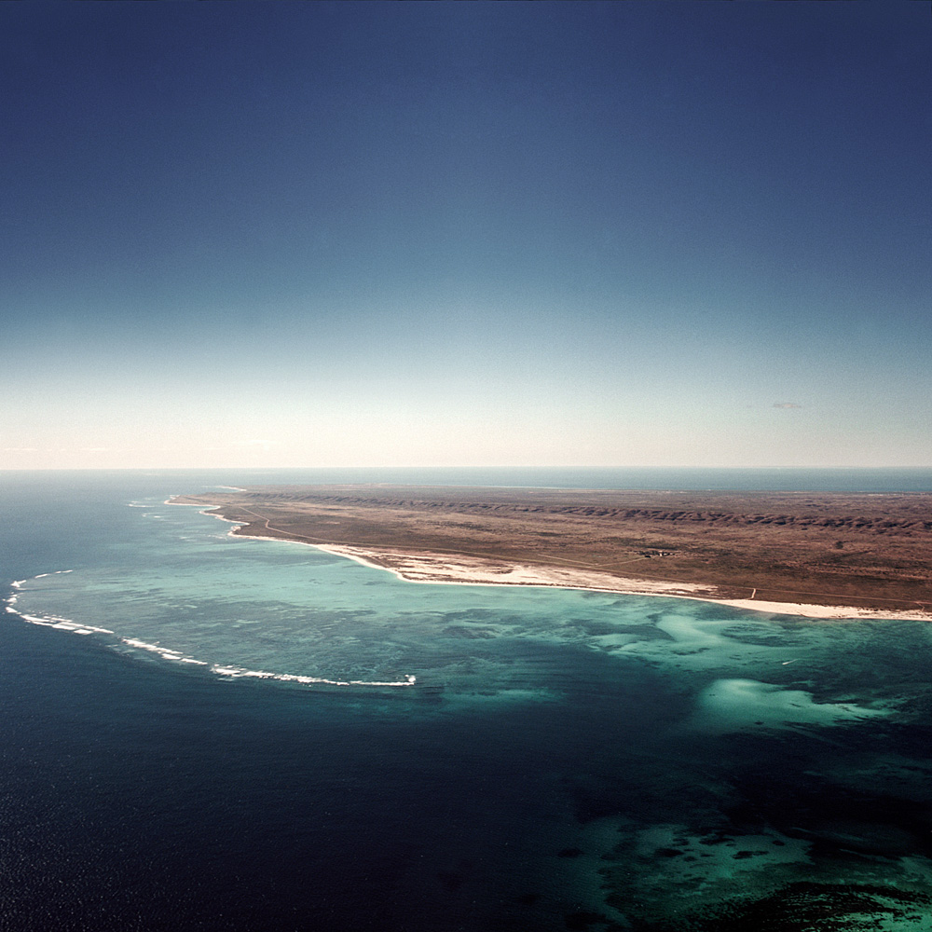
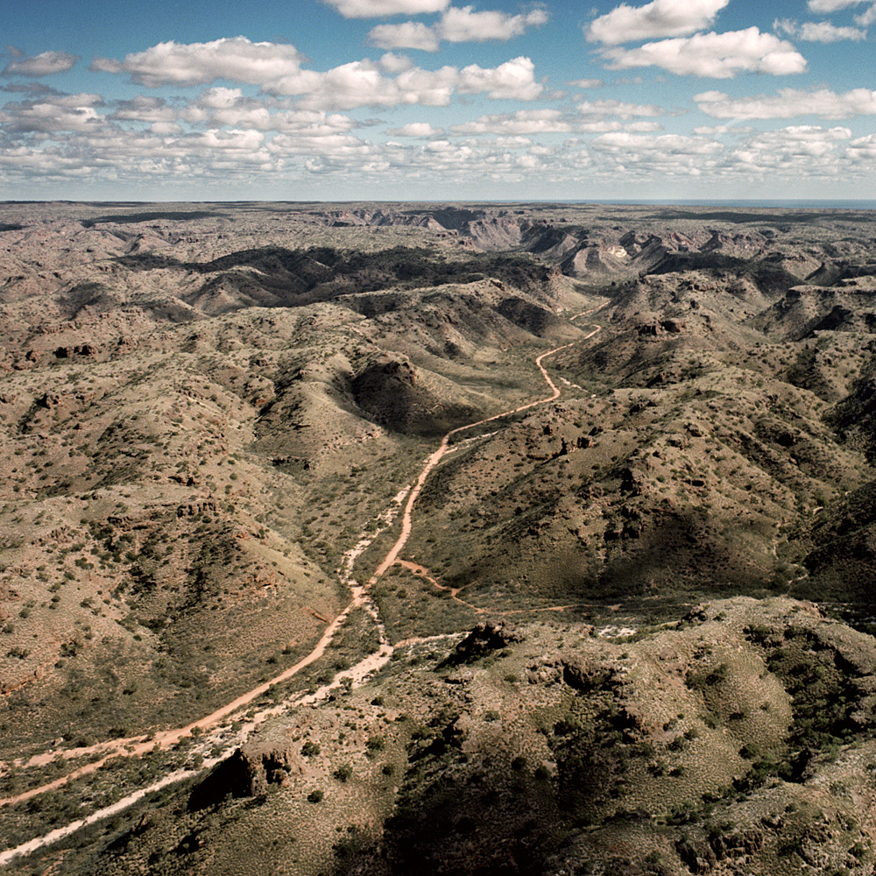
Capturing the Cape: David Jo Bradley
Findings

Slide 12
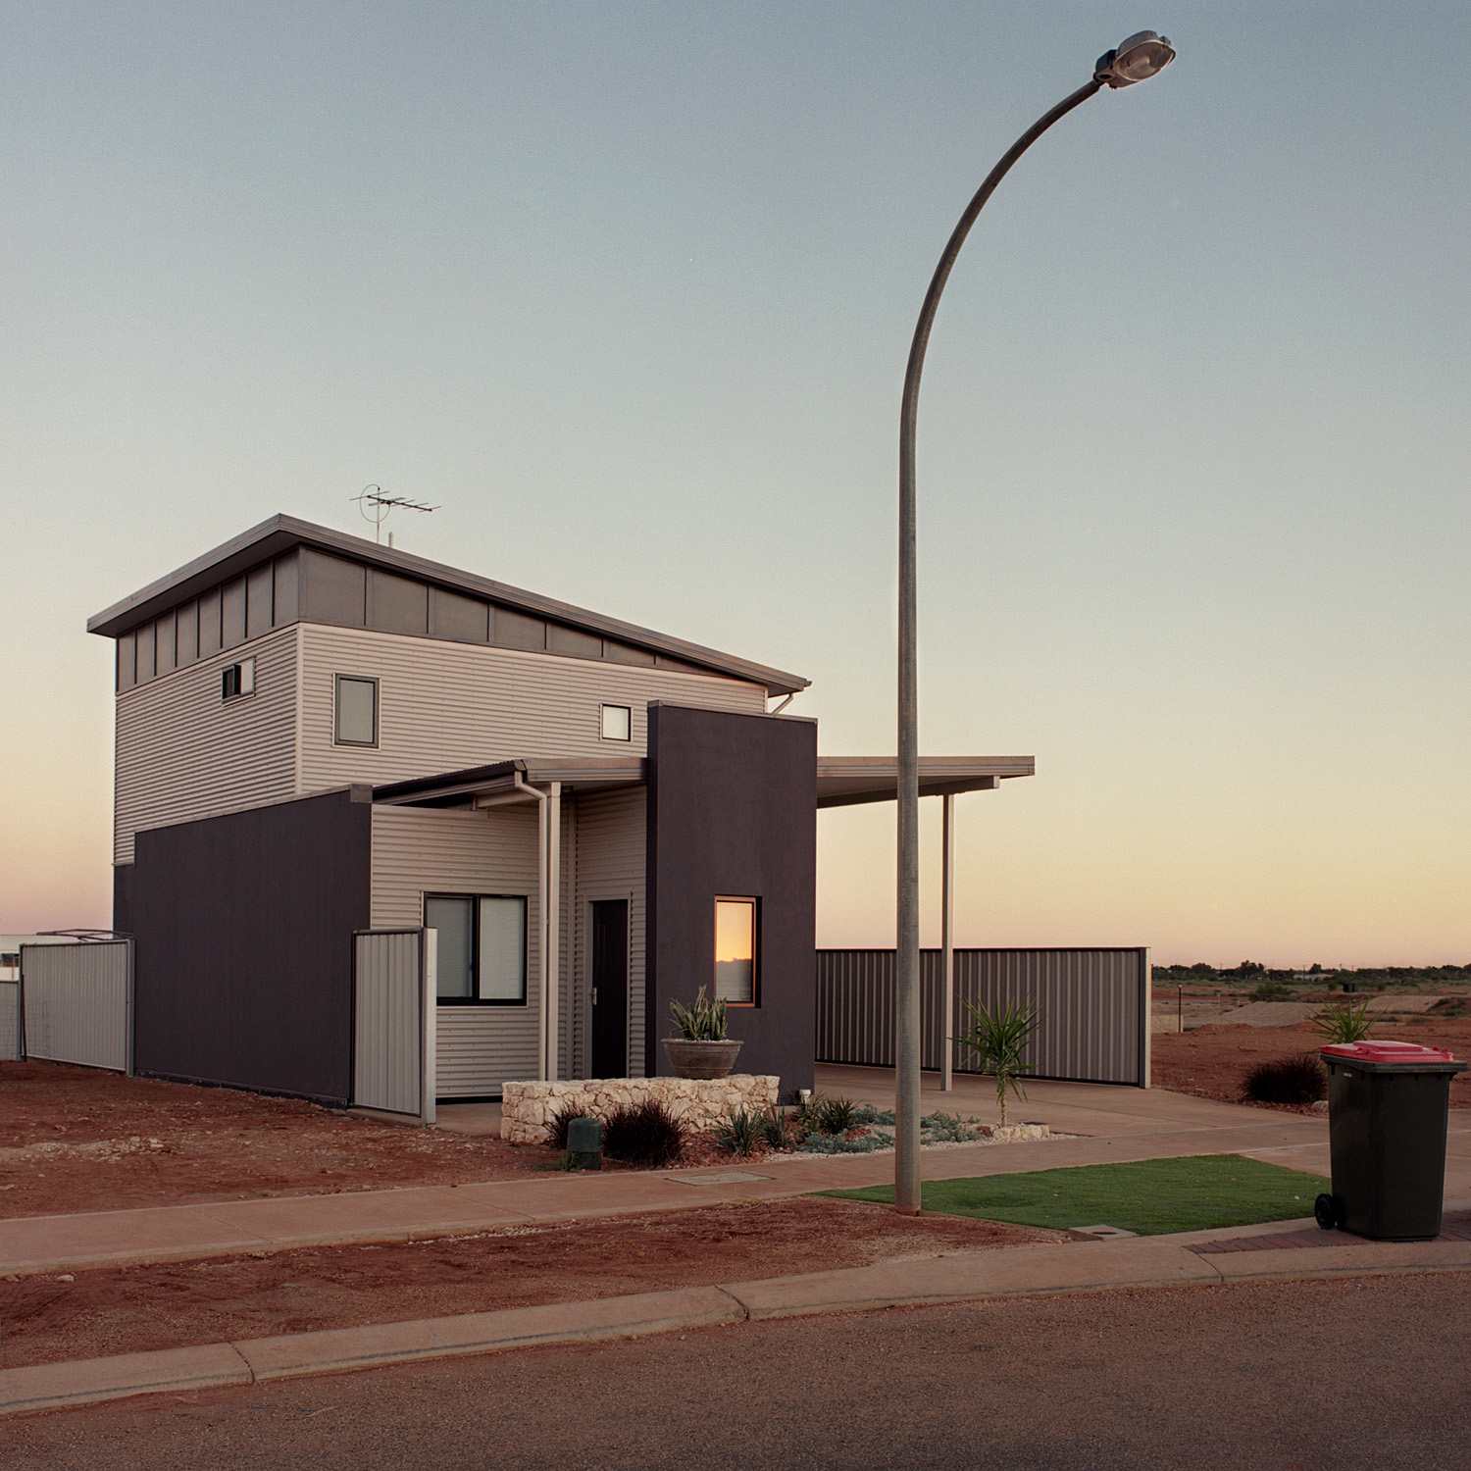
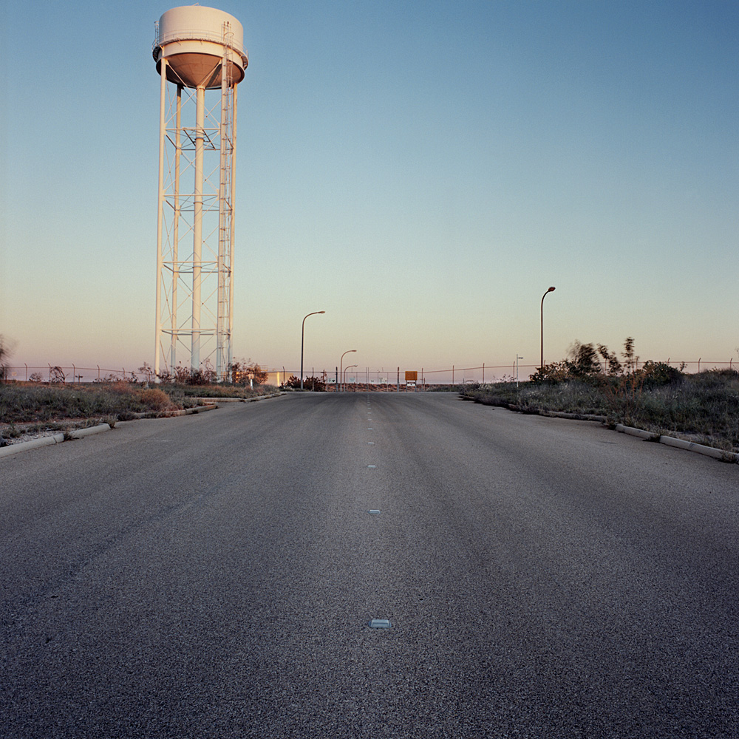
Capturing the Cape: David Jo Bradley
Findings

Slide 13
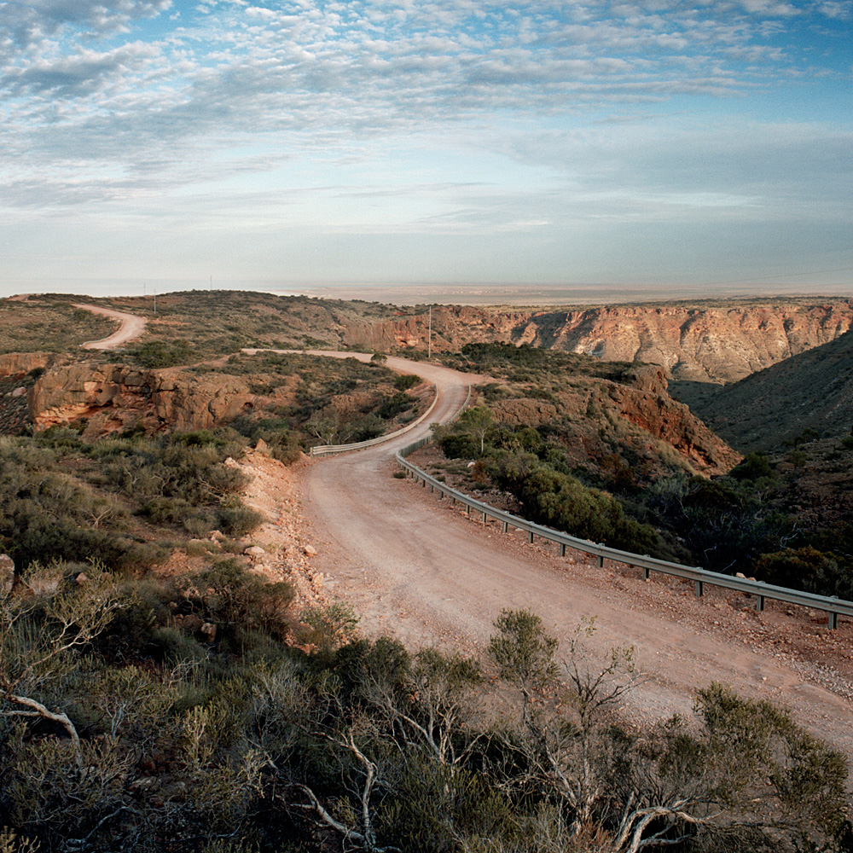
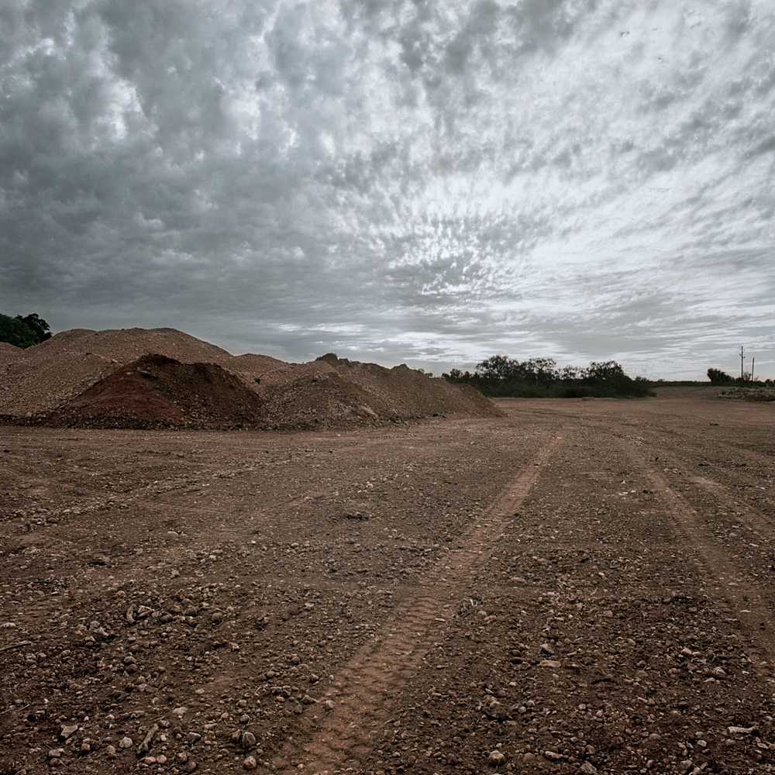
Capturing the Cape: David Jo Bradley
Findings

Slide 14
Capturing the Cape: David Jo Bradley
Limitations, Further Study
Bias of Photographer on the Findings
Issue of subjectivity and photographic veracity
A photographer cannot use operate a camera without injecting their view of the world
Lack of Indigenous Historical Reflection
Very difficult to find strong, reliable information in a short space of time
More Comprehensive Cultural Study of Wider Region
The subject of human influence over the Northwest of WA is huge
There is potential for a project incorporating a broad study of the cultural aspects over a longer period of time.

