Slide 1
Cognition Research Group
Craig Speelman
School of Psychology
and Social Science

Slide 2
Staff
Director: Professor Craig Speelman
Members:
  Dr Guillermo Campitelli
  Matthew Merema
  Katrina Muller Townsend
  Ronniet Orlando

Slide 3
Research Areas
General
  Cognitive Psychology
Specific
  Memory
  Skill acquisition
  Expertise
  Decision making

Slide 4
Projects
The role of automaticity in the development of cognitive skill
The role of expertise in judgement and decision making
Re-evaluating self-reports of memory: Do affect and personality moderate the accuracy of subjective memory complaints?
Building financial literacy and retirement savings engagement by developing a financial education program for the workplace

Slide 5
Projects continued
The role of cognitive reflection on saving behaviour
Effects of live versus recorded music and stories on salivary biomarker indicators of pain, anxiety and immune function in palliative care cancer patients
Development of a computer game to facilitate the acquisition of arithmetic skills

Slide 6
Using Psychological Theory to Improve Arithmetic Skills: The Numbeat Computer Maths Game.
Craig Speelman
Cognition Research Group

Slide 7
Australia’s Maths crisis
Over 50% of the adult population are functionally innumerate (ABS, 2006)
The proportion of high school students attempting higher level maths in Yrs 11&12 is declining
Universities are not producing sufficient maths and science graduates to meet Australia’s technological needs

Slide 8
Australia’s Maths crisis
What is causing this problem?
  Many factors
  Crammed curriculum
  Insufficient practice on the basics
  Arithmetic relies on mastering lower levels (e.g., counting) before attempting higher levels (e.g., addition)

Slide 9
Different Children = Different Learning Rates
Monitoring learning rates in a class of 20-25 children:
  pace of the lesson too slow
  pace of the lesson too fast
  Mastering one skill before attempting the next.
  “Maths Brain”

Slide 10
Computers: The great saviour?
Computers have been around since late 1970s
Coincides with slide in maths skills!
Whatever they’ve been doing, it’s not working!

Slide 11
Cognitive Skill Acquisition
25 years researching the
acquisition and transfer of
cognitive skills.
Book that reviews over
100 years of research
5 Principles of Skill Acquisition

Slide 12
Principles
Practice leads to faster performance
Practice leads to efficiencies in knowledge access
Learning leads to less demand on working memory
As expertise increases, fewer mental resources are required to perform a particular skill, enabling the development of a hierarchy of skills
Skilled behaviour involves execution of component processes

Slide 13
Current Computer Games
Study Ladder, Mathletics, Timez Attack, DaisyMaths
Little attention to principles (i.e., no scientific rationale)
Translation of paper-based exercises to screen
No data on their effectiveness

Slide 14
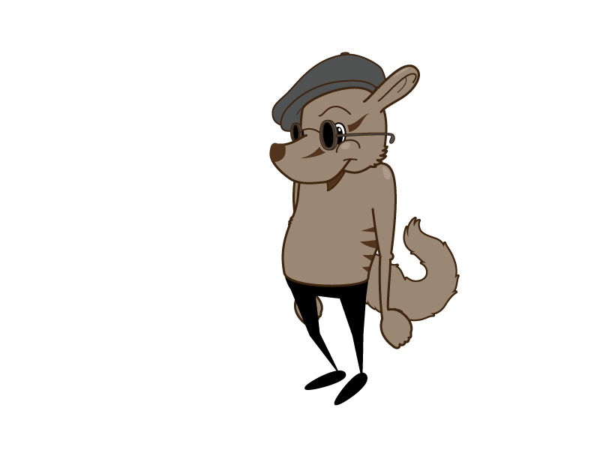
Numbeat
Designed according to
5 Principles
Designed to provide
teachers with feedback
about student’s
performance
Trial of its effectiveness

Slide 15
Numbeat Trial
Phase | Group 1 | Group 2 | Group 3 | Group 4
20-30 minutes | Pre-Test | Pre-Test | Pre-Test | Pre-Test
2 weeks 20-30 mins/day | Numbeat - Full | Numbeat – Limited (no speed up) | Control 2 (Drill problems) | Control 1 (Nothing)
20-30 minutes | Post-Test | Post-Test | Post-Test | Post-Test

Slide 16
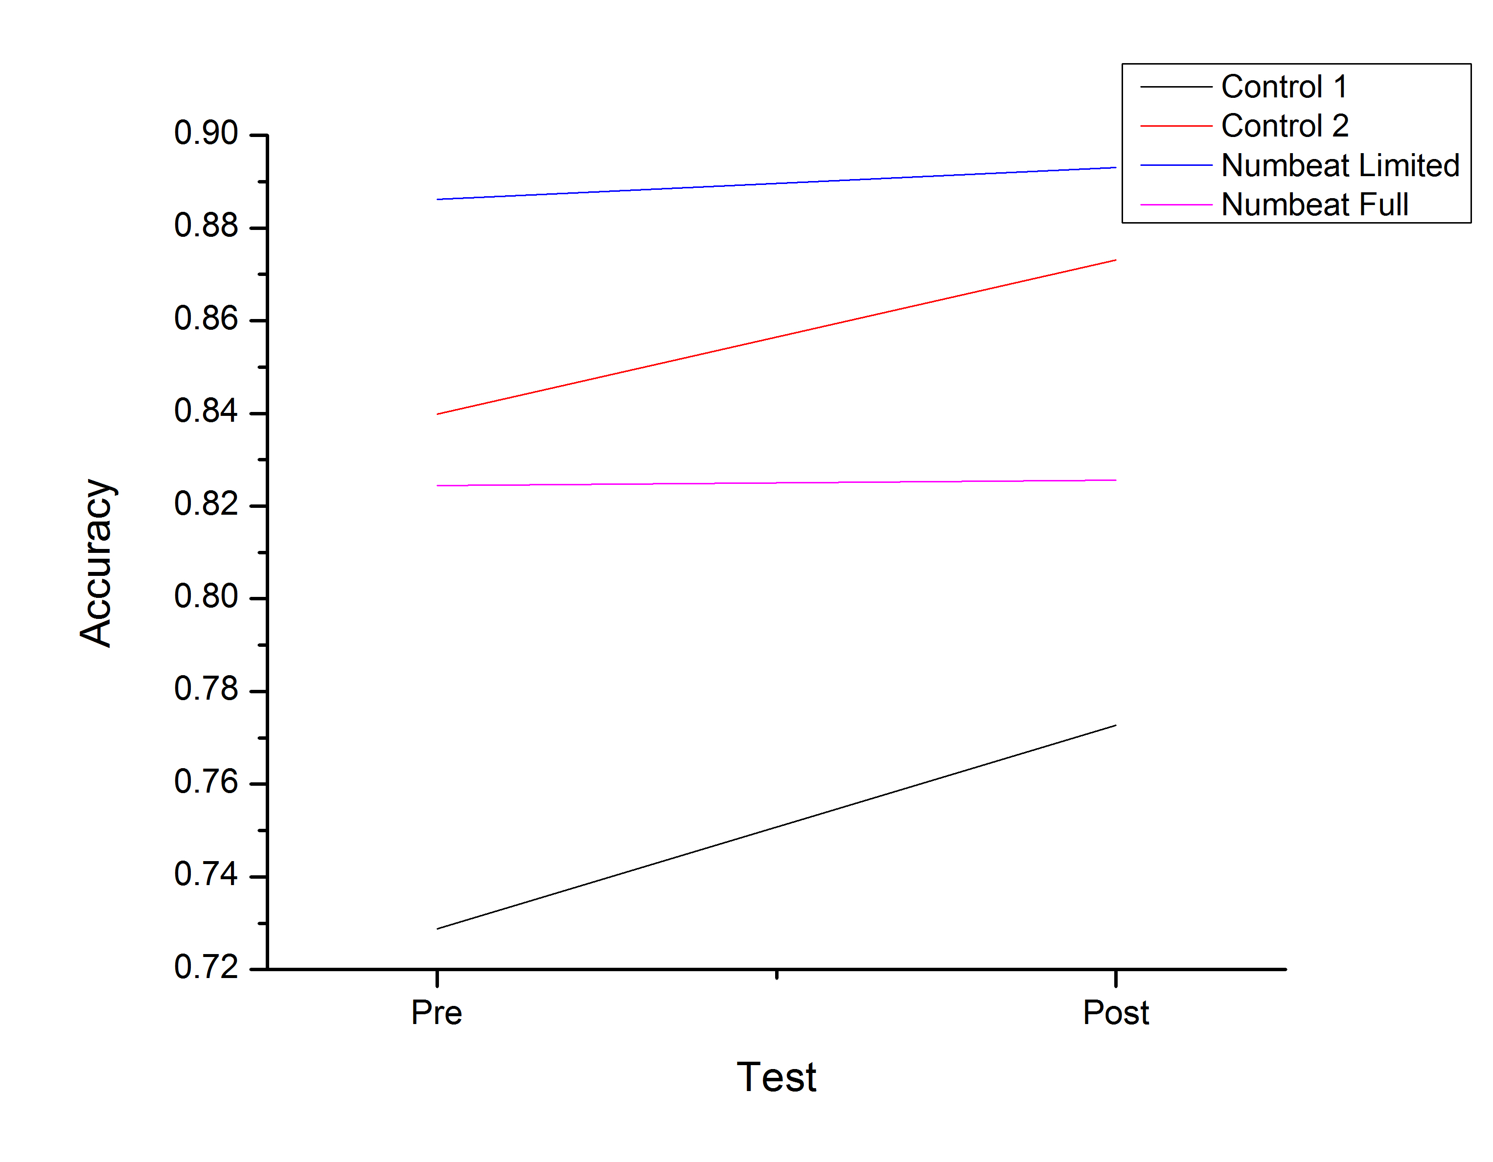
Trial Results - Accuracy

Slide 17
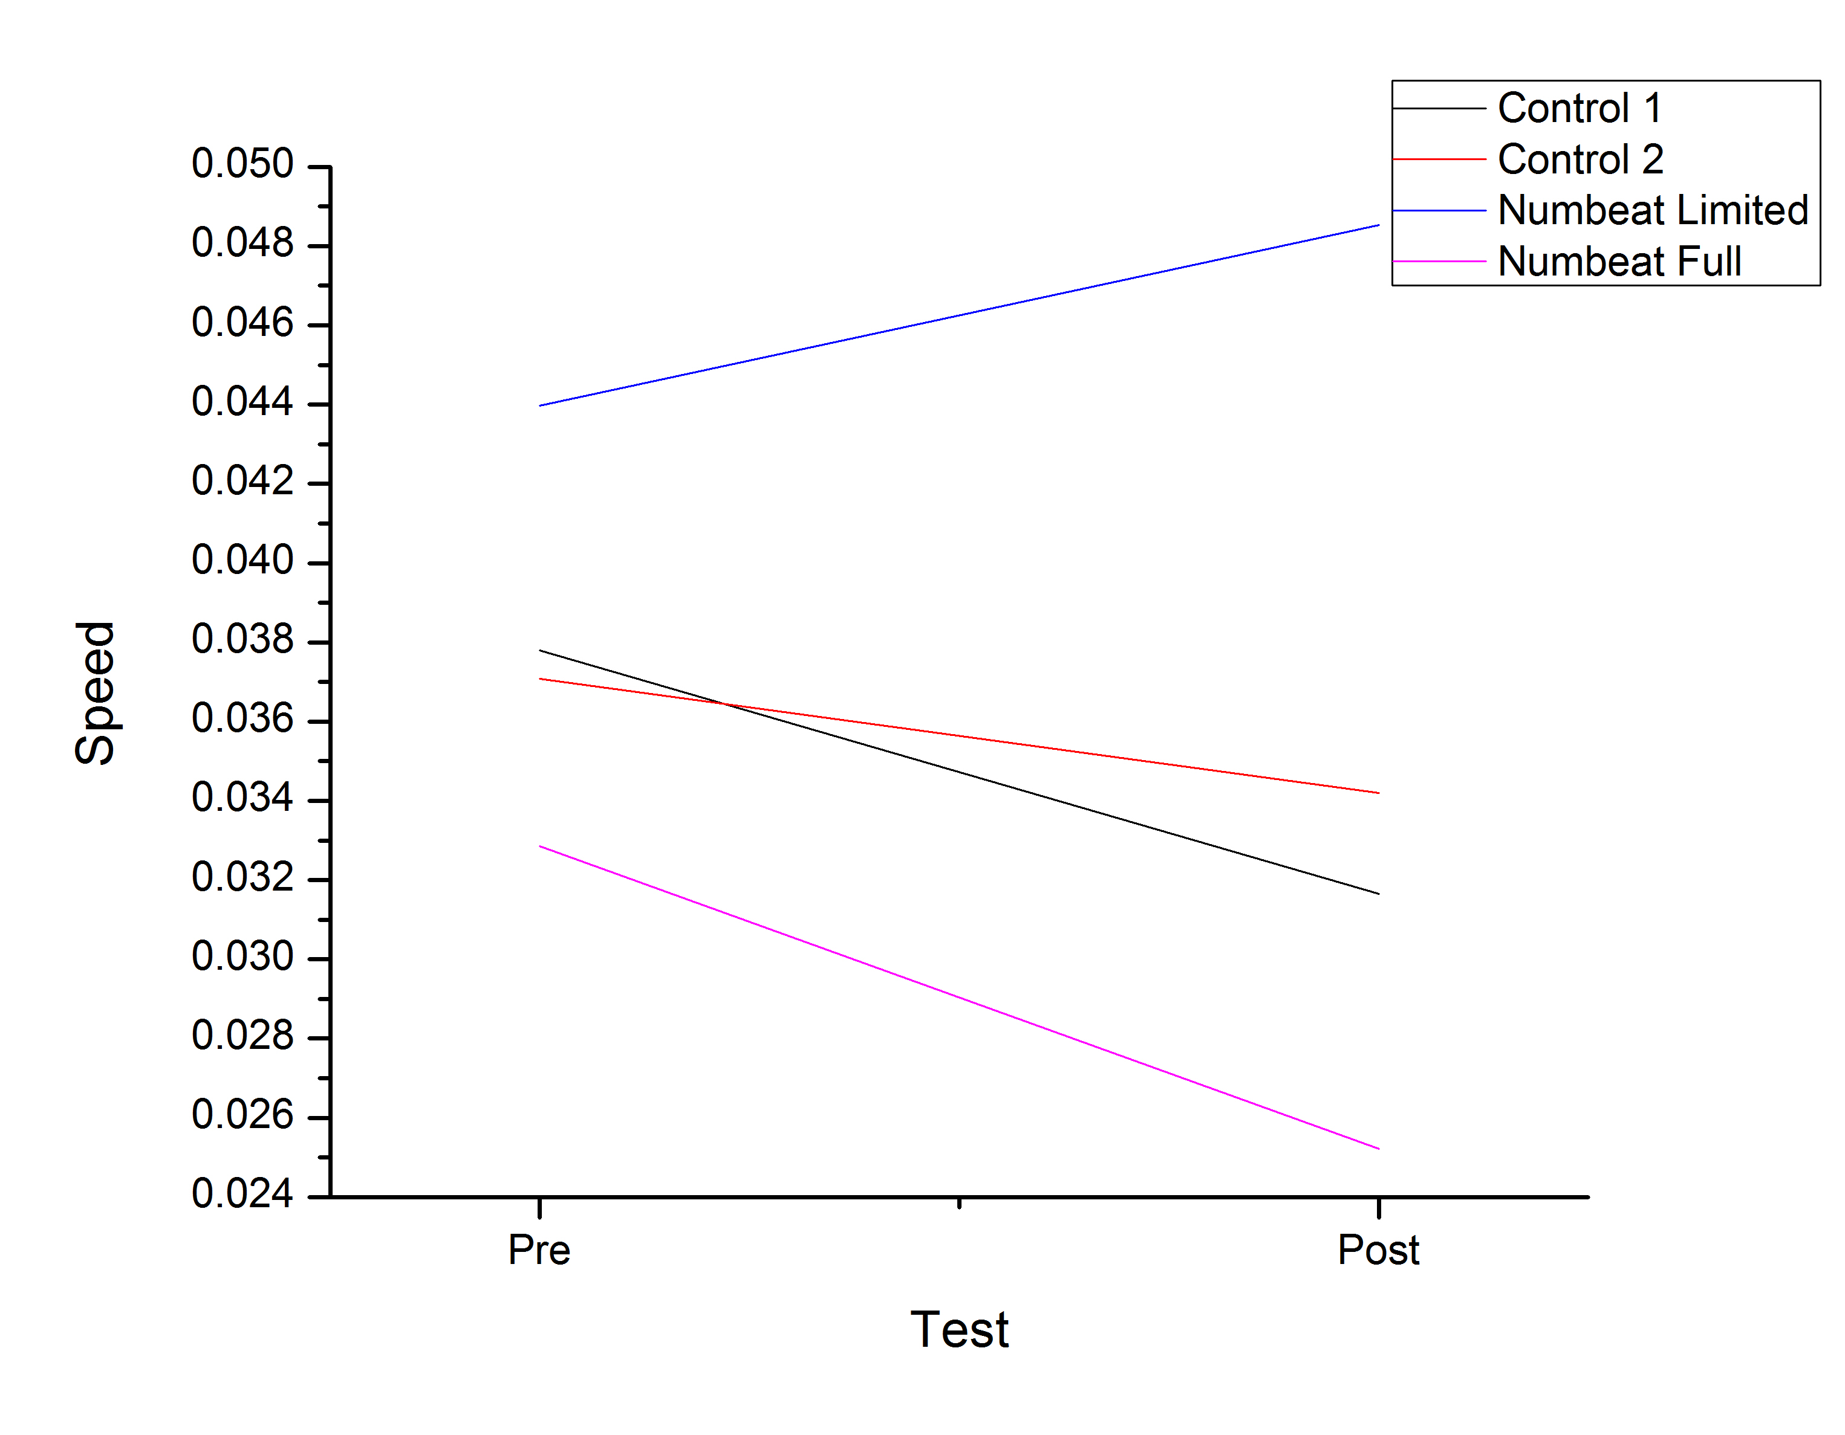
Trial Results - Speed

Slide 18
Conclusions
Acc increased in all conditions, but rate of improvement was same across conditions
  general practice effect?
Speed decreased in all conditions, except Numbeat-Limited
  Numbeat-Limited effective in improving speed
Numbeat-Full possibly too difficult for students to cope with
  Benefits not realised?

Slide 19
Numbeat Trial #2
Technical Issues solved
3rd party server issues eliminated – all programs run from Numbeat server
Trial designed to examine whether a Numbeat version in between Numbeat-Limited and Numbeat-Full is more effective
  Speed-up elements will be manipulated so that they are retained, but not as severe
Conditions will be manipulated within a class, to eliminate possible class/school differences.

