Slide 1
Improving Decision Making: The use of simple heuristics
Dr. Guillermo Campitelli
Cognition Research Group
Edith Cowan University

Slide 2
3 ways of improving decision making
Acquiring knowledge (specific)
Example: chess grand masters
Using formal methods
Example: Rules of logic, Statistics, Decision Theory
Using simple heuristics
Example: Recognition Heuristic

Slide 3
Simple heuristics
Is using simple heuristics a sound strategy?
Research by Gigerenzer and others presents evidence that people use simple heuristics
There is also evidence that using simple heuristics, in some circumstances, is better than using complex strategies

Slide 4
Ecological rationality (Gigerenzer and colleagues)
Simon’s (1955) bounded rationality
Limitations of the cognitive system
Good adaptation to the environment
People use fast-and-frugal heuristics that “make us smart” (Gigerenzer et al., 1999)

Slide 5
Recognition Heuristic
If one of two objects is recognised and the other is not, then infer that the recognised object has the higher value with respect to the criterion
Which city has more inhabitants:
Hamburg or Solingen?
Recognition Heuristic: If Hamburg is recognised and Solingen is nor recognised, choose Hamburg as the city with more inhabitants.

Slide 6
Recognition Heuristic
What happens when using the RH is clearly a bad strategy?
Example: Vatican City against an unrecognised city

Slide 7
Suspension of the Recognition Heuristic (Pachur & Hertwig, 2006)
RH is the default strategy
Hypotheses of why RH is not always used:
H1: Threshold hypothesis
H2: Matching hypothesis
H3: Suspension hypothesis:
The non-use of RH is related to object-specific knowledge that is at odds with recognition (e.g., recognition of a city with a very small population)

Slide 8
Goals of the study
Cities environment
Investigate the non-use of RH
Run a model comparison between models that involve RH, suspension of RH, and knowledge beyond recognition

Slide 9
Methods
Cities environment
Creation of an environment of low recognition validity
Mean recognition validity = .47
Recognition correlation = .04
Material
8 cities
28 pairs
Tasks
Choice: “Which of these cities has a higher number of inhabitants?”
Recognition: “Did you know that there was a city with such name, before participating in the experiment?”
Participants
59 psychology students at Universidad Abierta Interamericana, Buenos Aires, Argentina
Variables
Popularity (high, low)
Population (large, small)

Slide 10
Methods
Analyses
χ² analyses of choices of each city as a function of population and popularity
Model comparison
Maximum Likelihood Estimation (MLE), Bayesian Inference Criterion (BIC)
Deterministic
Probabilistic

Slide 11
Cities: Design
Popularity | Population | Low | High
Small | Kwinana (.029) Kaga-Bandoro (.056) | Vatican City (.001) Luxembourg (.088)
Large | Addis Ababa (3.384) Kiev (2.797) | Paris (2.211) Madrid (3.273)
Population of each city in millions of inhabitants.

Slide 12
Cities-Results: Recognition
Popularity | Population | Low | High
Small | Kwinana (.19) Kaga-Bandoro (.05) | Vatican City (.92) Luxembourg (.95)
Large | Addis Ababa (.05) Kiev (.44) | Paris (1) Madrid (1)
Proportion of participants that recognise each city

Slide 13
Cities-Results: Choices
Popularity | Population | Low | High
Small | Kwinana (.38) Kaga-Bandoro (.31) [.35] | Vatican City (.48) Luxembourg (.62) [.55]
Large | Addis Ababa (.29) Kiev (.38) [.34] | Paris (.73) Madrid (.80) [.77]
Proportion of choices of each city across all participants (59) and pairs (7) | Χ²(1) = 11.646,
p < .0007

Slide 14
Number of choices as a function of popularity and size

Slide 15
Results
Results averaged across participants:
Recognition: M = .57 (SD = .12)
Choice accuracy: M = .54 (SD = .10)
Use of RH
78 % of choices across participants and pairs

Slide 16
Models
RHg
Recognition heuristic + guess
RHsg
Recognition heuristic + suspension + guess
RHsur
Recognition heuristic + suspension + unrecognised
KH
Knowledge Heuristic
If one knows more about one city than the other, one should choose the city that one knows as the one with the higher value in the criterion
CK
Criterion Knowledge
RND
Random

Slide 17
Knowledge Heuristic: Yahoo
Popularity | Population | Low | High
Small | Kwinana (6.21) Kaga-Bandoro (4.08) | Vatican City (7.85) Luxembourg (8.15)
Large | Addis Ababa (7.03) Kiev (7.75) | Paris (9.02) Madrid (8.58)
Log₁₀ of number of pages the name of the city appears in the internet, using Yahoo search engine

Slide 18
Procedure of calculations
Values of both items in each pair
Difference between values
Probability of choosing Item 1 given the model
Probability of actual choice given the model
2 types of probability models:
All or none
Probabilistic
Log-likelihood
BIC
All the previous calculations in each participant
Classification of participants as users of the model with lower BIC

Slide 19
Probability of choosing Item 1 in pair j, given model k
All or none
Probabilistic

Slide 20
Probability of actual choice in pair j given model k
All or none
Probabilistic

Slide 21
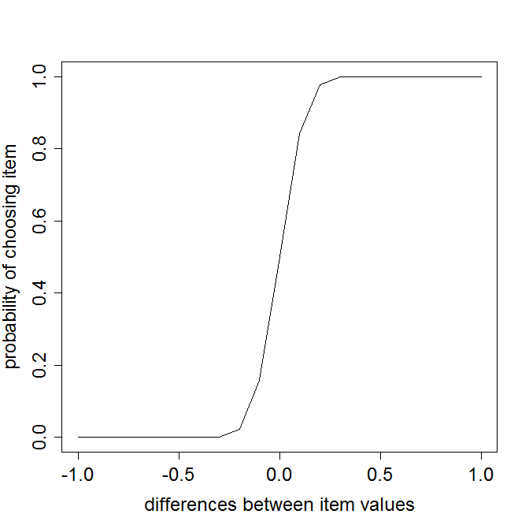
Sd .1

Slide 22
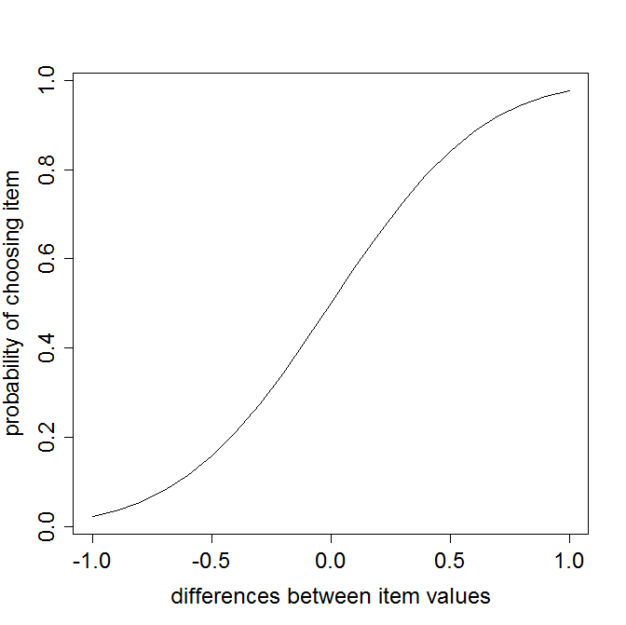
Sd .5

Slide 23
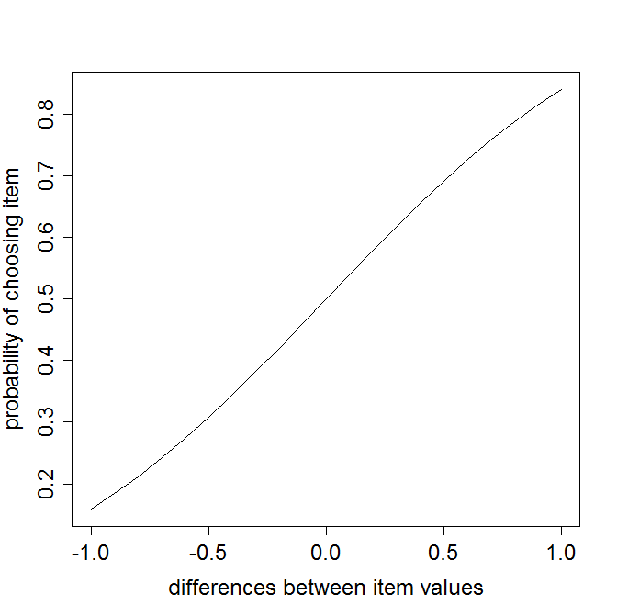
Sd 1

Slide 24
Model comparison
Log-Likelihood
Bayesian Information Criterion (BIC)

Slide 25
Model comparison: Results
 |  | Models
Type | Measure | RHg | RHsg | Rhsur | KH | CK | RND
All or None | Mean LL | -44.69 | -48.27 | -101.11 | -49.49 | -49.49 | -19.41
 | MeanBIC | 89.38 | 96.55 | 202.22 | 98.98 | 98.98 | 38.82
 | # wins | 10.00 | 5.00 | 0.00 | 9.00 | 9.00 | 40.00
Probabilistic | Mean LL | -16.21 | -17.46 | -19.88 | -15.68 | -20.40 | -19.41
 | MeanBIC | 35.75 | 38.25 | 43.10 | 34.69 | 44.12 | 38.82
 | Mean σ | 0.78 | 0.84 | 1.93 | 3.56 | 3.44 | NA
 | # wins | 23.00 | 8.00 | 2.00 | 10.00 | 6.00 | 11.00

Slide 26
Discussion
RH was the most popular strategy
The use of RH was not adaptive
The use of strategies is independent from the ecological validity of the strategy

Slide 27
Conclusion
People sometimes use available strategies, and sometimes guess
RH is one of these strategies
The use of strategies does not seem to be related to their usefulness

Slide 28
Conclusion
Can we improve decision making by using simple heuristics?
Yes, but a degree of knowledge is required to successfully decide when it is appropriate to use the simple heuristic

Slide 29
Thank you!

